Slide 1
Making Sense of Course Evaluations: A Practical Guide
Learn how to read, interpret, and use student feedback to improve your teaching experience.

Slide 2
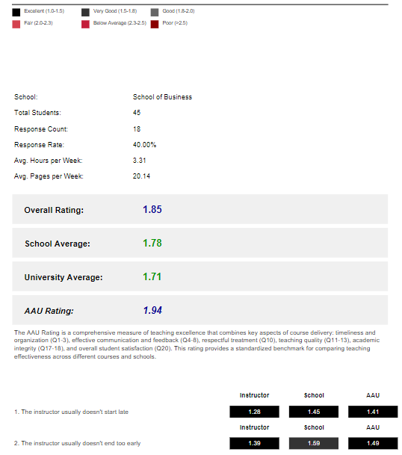
Breaking Down Your Course Evaluation Report
Your course evaluation report is more than just numbers! It gives you a roadmap for improvement. Here’s how it’s structured:
Section | What It Tells You
📌 Course Information | Response rate, class size, student engagement
⭐ Overall Ratings | How your score compares to school & university averages
📊 Question Breakdown | Which areas scored high/low and why
💬 Student Comments | Direct feedback on what works and what doesn’t

Slide 3
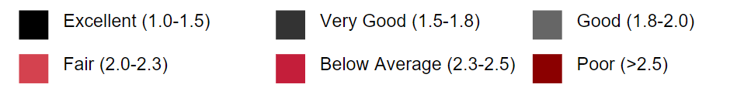
Understanding Your Course Rating
Core Explanation
Course evaluations at AAU use a 1–5 scale, where lower scores indicate better performance – just like the Czech grading system. Your score determines your overall rating and how your course compares to others. 📌 Your final rating is based on student responses to key evaluation questions.
➡️ A rating of 1.0–1.5 means outstanding teaching performance, while anything above 2.5 suggests areas where adjustments could improve student experience.

Slide 4
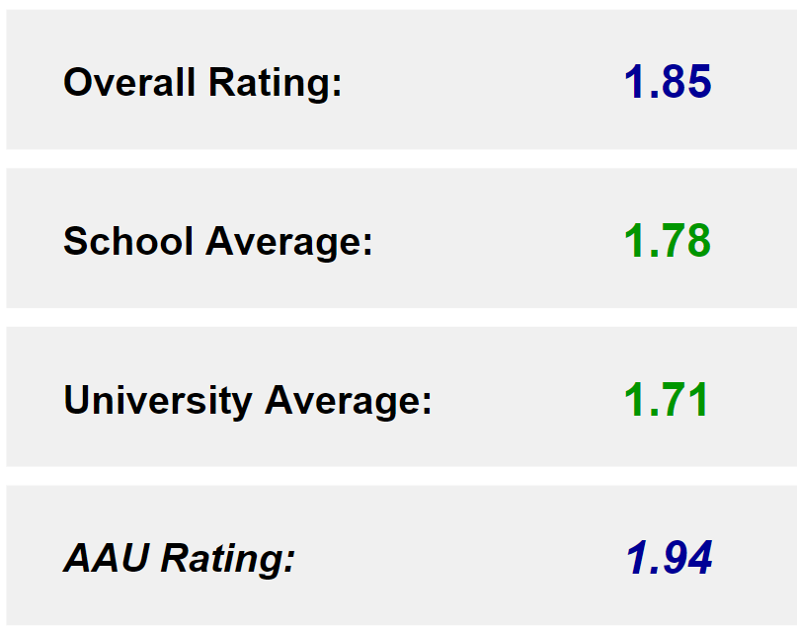
Understanding Your Course Rating
Your course rating is more than just a number—it’s a tool for growth.
📌 How to use this?
✔️ If your rating is close to or better than the average, this suggests your course structure and teaching methods align well with student expectations.
✔️ If a category is slightly higher than the average, consider reviewing student comments for patterns—Are students asking for more interactivity? Clearer instructions? Faster feedback?
✔️ If a category is significantly above the school or university average, reviewing student comments may reveal small changes that could enhance engagement.

Slide 5
Evaluation Questions
Questions in red are included in the AAU Rating calculation
Q# | Question Text | In AAU Rating
4 | The instructor usually doesn't start late. | ✓
5 | The instructor usually doesn't end too early. | ✓
6 | The instructor follows the schedule and covers all contents. | ✓
7 | The instructor responds to emails in a timely manner. | ✓
8 | The instructor provides feedback on assignments in a timely manner. | ✓
9 | I received first substantive feedback by week 5. | ✓
10 | I get useful feedback on questions, homework and exams. | ✓
11 | The instructor is available for advice and help. | ✓
12 | I use the instructor's consultation hours.
13 | The instructor treats students fairly and with respect. | ✓

Slide 6
Evaluation Questions
Questions in red are included in the AAU Rating calculation
Q# | Question Text | In AAU Rating
4 | The instructor usually doesn't start late. | ✓
5 | The instructor usually doesn't end too early. | ✓
6 | The instructor follows the schedule and covers all contents. | ✓
7 | The instructor responds to emails in a timely manner. | ✓
8 | The instructor provides feedback on assignments in a timely manner. | ✓
9 | I received first substantive feedback by week 5. | ✓
10 | I get useful feedback on questions, homework and exams. | ✓
11 | The instructor is available for advice and help. | ✓
12 | I use the instructor's consultation hours.
13 | The instructor treats students fairly and with respect. | ✓
14 | The instructor encourages participation, discussion and questions. | ✓
15 | The instructor gives good examples to help me understand difficult concepts. | ✓
16 | The instructor makes me think more critically about this subject. | ✓
17 | The course has a clear method of grading.
18 | The exams, quizzes, and assignments adequately cover the syllabus contents.
19 | The instructor is fair in evaluating and grading the students. | ✓
20 | I did not witness any form of cheating or plagiarism in this course.
21 | I would gladly take another course by this instructor. | ✓
22 | The course is challenging and requires regular preparation. | ✓
23 | I have learned a lot in this course. | ✓

Slide 7
What Students Say: Understanding Their Feedback
The final section of your evaluation report contains verbatim comments from students, organized into three categories:
📌 What Works Well? (Strengths)
✔ “The professor explains complex topics clearly and gives useful real-world examples.”
✔ “The class discussions were engaging and helped deepen my understanding.”
⚠️ What Could Be Improved?
🔹 “Sometimes the pace was too fast, and we didn't have enough time to fully explore complex topics.”
🔹 “The professor wasn’t always available during office hours.”
💡 Student Suggestions for the Future
🛠 “Maybe provide more practice problems before the midterm exam.”
🛠 “It would help to have more consistent office hours, especially before major assignments.”
Individual comments may vary, but patterns reveal key insights.

Slide 8
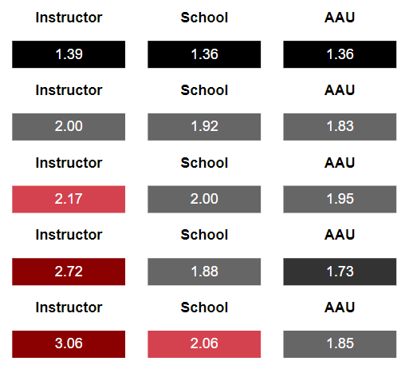
How to Use Course Evaluations Effectively
Three Key Strategies for Success
📌 1. Review Evaluations with a Clear Focus
✔ Don’t just look at the overall rating—identify specific strengths and areas for refinement.
✔ Look for patterns across multiple semesters, not just one-off issues.
✔ Pay attention to both quantitative scores and student comments—they provide context.

Slide 9
How to Use Course Evaluations Effectively
Three Key Strategies for Success
🛠 2. Set Realistic, Measurable Goals ✔ Instead of broad changes, choose 1-2 key improvements to implement per semester. ✔ Example:
“Students wanted more interactive discussions.”
Action: Add one discussion-based activity per week. ✔ Track if students respond positively in the next evaluation cycle.

Slide 10
How to Use Course Evaluations Effectively
Three Key Strategies for Success
🚀 3. Close the Feedback Loop – Let Students Know You’re Listening ✔ When you implement changes, tell students why! ✔ Example:
“Many of you suggested more practice materials before exams—so I’ve added a study guide!” ✔ When students see that feedback leads to improvements, they are more likely to engage in future evaluations.

Slide 11
Why This Approach Works?
✅ Clear priorities – No need to overhaul your teaching—small tweaks have big impact.
✅ Student engagement – When they see changes, they participate more.
✅ Better results over time – Iterative improvements lead to stronger evaluations.

Slide 12

Next steps
📊 Planned Improvements to AAU Rating Methodology
⚖️ The Learning Outcomes and Assessment Committee will review and suggest question weights based on the relevance of each question.
🔢 A regression model will be developed: 👥 Class size 📚 Weekly reading load ⏱️ Reported preparation hours
✅ Goal: A fairer, data-driven evaluation process.

Slide 13
Thank You!
1️⃣ What is one key insight you learned today?
2️⃣ Any questions or concerns? Let’s discuss!

