Slide 1

New Faculty Orientation
Dr. Angel Hoekstra, Director
Center for Teaching & Learning
Anglo American University
January 23, 2025

Slide 2

Welcome to Anglo American University!
We are pleased to have you here and
we hope you find this orientation
engaging & useful.

Slide 3
Outline for today
Introductions
Education Principles, paired discussions
Semester Calendar, then workshop time:
Learning Management System (NEO)
Virtual classroom (MS Teams)
30 minute lunch break
Class Cancellation policy
Attendance, Grading, Plagiarism
Group discussion: Personalized Learning

Slide 4

Ice-breaker: Introductions
Around the room & online, please tell us:
Name
Course/s you will teach at AAU
Your favorite food or dessert… either from your country of origin or from a culture you have visited
Please keep your introduction
to 2 minutes, thanks.

Slide 5

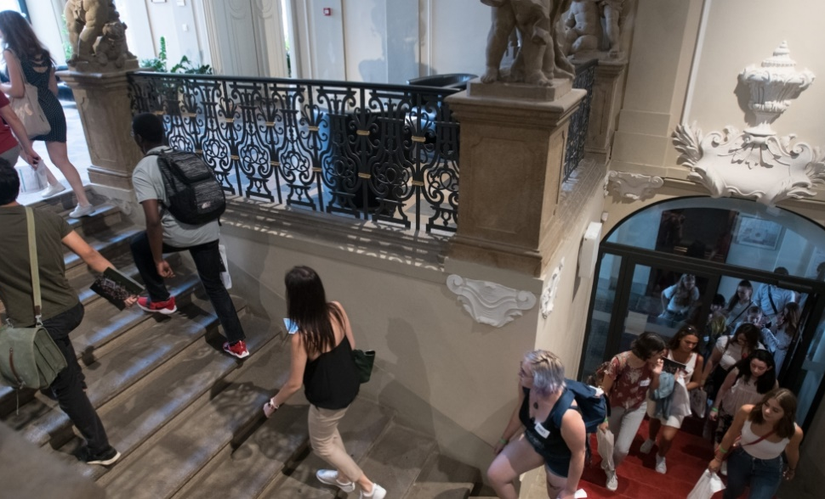
AAU Education Principles
Professionalism
Interactivity
Complexity
Enthusiasm
441603010

Slide 6
Thinking critically about teaching
Professionalism Interactivity
Complexity Enthusiasm
“Despite our habit of talking as if teaching were just the moment when someone stands and explains something to someone, teaching is complex. Teaching is complex because human beings are complex, and to teach is to try to help human beings grow. As people interact around learning tasks, they come to them with a range of motivations, limitations, beliefs, feelings, fears, expectations, gifts and weaknesses.”
On Christian Teaching, David Smith, 2018, p.28

Slide 7
Thinking critically about teaching
Professionalism Interactivity
Complexity Enthusiasm
“… How the learning unfolds is influenced by physical space: the layout of the furniture, sight lines, lighting, postures… it is also influenced by timing: pace, silences, repetition, anticipation, beginnings, endings, promises, reminders… Behaviors don’t just happen, they are witnessed, interpreted, judged and responded to. Ideas are not just explained or covered, they are accepted, contested, adapted, joined, isolated, cast aside or applied.” (D. Smith, 2018)
What kind of teaching will you do at AAU?

Slide 8
AAU Education Principles
Professionalism
Interactivity
Complexity
Enthusiasm
Qualitative data from the
2023 AAU Student Survey,
to the open-ended question:
“What do you wish faculty/professors at AAU knew about students?”
N = 126 responses

Slide 9

Education Principles
Professionalism
Be prepared, know timing for break/s
Follow the schedule, syllabus
Email your students the syllabus, through NEO, the week before class begins
Student comment, 2023 data:
“First-year students don't always know how things work at AAU or at university in general, so your patience is very appreciated.”

Slide 10
Education Principles
Professionalism
Be prepared
Follow the schedule
Hold consultation hours
Tell your students verbally, in class on the first day and on occasion, that you are available to meet with them
Offer to talk briefly at breaks and/or ask students to schedule with you by email for a date and time
At the Café or before/after class

Slide 11
Education Principles
Professionalism
Hold consultation hours
Remind them when you are available
Consider: Do you prefer a student come to you with a specific question, or can they just ask to meet with you to discuss the material in general (e.g., before exams)?
Student comment, 2023 data:
“I wish the faculty/professors knew that AAU students have lives and obligations outside of school. Yes, we are here for school and while that is important, some of us need to make time for a social life and jobs.”

Slide 12
Education Principles
Professionalism
Be prepared
Follow the schedule
Hold consultation hours
Provide timely feedback
In written form on assignments
In verbal form before or after class
In scheduled office hour consultations
Online in Teams/NEO (online students)
By email for questions (e.g., absences)

Slide 13

Giving Effective Student Feedback
Feedback should include:
Data about what the student has done well, as well as what might be improved upon in future assignments (in your class or others)
E.g., How to cite correctly
E.g., How to apply a theory
E.g., How to critique or
offer peer review feedback

Slide 14
Effective Feedback In NEO or hand-written
Sets high expectations
Corrects specific behaviors, shares knowledge, encourages application
Points to what the student did well
Reinforces confidence in the student’s ability to improve their performance
(Coyle, 2020 The Talent Code)

Slide 15
Education Principles
Professionalism
Be prepared
Follow the schedule
Hold consultation hours
Provide timely feedback
Do not act as “only an adjunct”
Never share grades in class
Speak only in English when you teach
It is acceptable to speak in another shared language in office hours ☺

Slide 16

AAU Education Principles
Professionalism
Interactivity
Do not just lecture. Implement ways to help your students participate & apply concepts.
E.g. 2-minute writing exercise → Think, Pair, Share

Slide 17
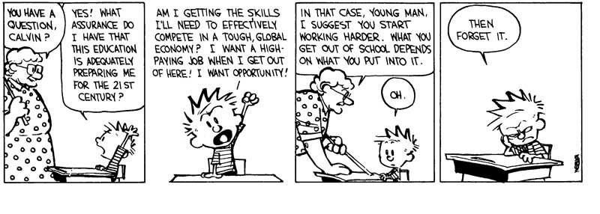
Data support the efficacy of active learning
The evidence that active learning approaches help students learn more effectively than transmissionist approaches is robust and stretches back more than thirty years
(see e.g., Bonwell & Eisen 1991; Hake 1998).

Slide 18
AAU Education Principles
Professionalism
Interactivity
Do not just lecture
Use diverse teaching methods: lecture, group discussions, paired discussions, video clip analysis, handouts, forums on NEO, field trips, simulations, be creative!
Student comment, 2023 data:
“Some students take time to get used to the class/professor, and that's why many of us don't actively participate in the beginning of a class.”

Slide 19

Data: Comments from AAU students 2022-23 faculty course evaluations
“I like how the professor is always supportive, presents information in an interesting way and is giving examples so that we can understand the concepts better. I also like that he's not just lecturing, but we also play some games, watch some movie clips, do discussions.”

Slide 20
Sometimes AAU Faculty members must teach in a Concurrent Learning Environment
Most often occurs when a student has a health problem, or trouble obtaining a visa in order to come to Prague
Please try to be understanding, or ask for help from me/the CTL Director (e.g., in a 1:1 meeting) for strategies in how to “run” a class well with both in-person and online students

Slide 21
Concurrent Learning Environment
Guidelines for Online Students:
If you must record a class on Teams, you must have your camera on.
All courses must be recorded in weeks 1 & 2, for students waiting on VISAs.
Sometimes students add your course after the first class so having recorded it makes things easier for everyone.

Slide 22
Guidelines for Using Teams
If you must record a class on Teams, you must have your camera on
You must record your class in weeks 1 & 2 (e.g., for students waiting on VISAs)
Once you have reached week 3, if every student on your student roster is present, there is no need to use Teams
E.g., I record in future weeks only if 2+ students are unable to attend (sick), and only if they inform me in advance

Slide 23
Data: Comments from AAU students 2022-23 faculty course evaluations
“This semester was fully in person, but I had to enter the class in Teams, and I think the dynamics were great… even though there were people in the classroom, I felt that I was there with them because of the interaction. I loved the opportunity for participation, because we were a small class and from different nationalities, so with every topic everyone contributed something from a different point of view. I also really enjoyed the field trip we made to the museum, getting to relate concepts seen in class with an object that made us feel something, it made me realize that everything seen in class was a real life term.”

Slide 24
AAU Education Principles
Professionalism
Interactivity
Great resource: https://cft.vanderbilt.edu/guides-sub-pages/active-learning/#evidence
“Active learning engages students in the process of learning through activities and/or discussion in class, as opposed to passively listening to an expert. It emphasizes high-order thinking and often involves group work.” (Freeman et al, 2014)
Paired discussions: Explain to a colleague one method you already use in class to support active/interactive learning.

Slide 25
AAU Education Principles
Professionalism
Interactivity
Complexity
Have at least one assignment where you assess students & give feedback by week 5
AAU requires you provide at least one form of assessment (a grade on NEO) by end of week 6
Student comment, 2023 data:
“It’s easiest to complete the assignments when the professor clearly states them in the syllabus and includes the assignments in the NEO calendar.”

Slide 26
AAU Education Principles
Professionalism
Interactivity
Complexity
Have at least one assignment where you assess students & give feedback by week 5
Use diverse assessment methods:
Exams, Reflection Papers, Critical Reading Responses, Research projects, Individual or group presentations, etc.

Slide 27
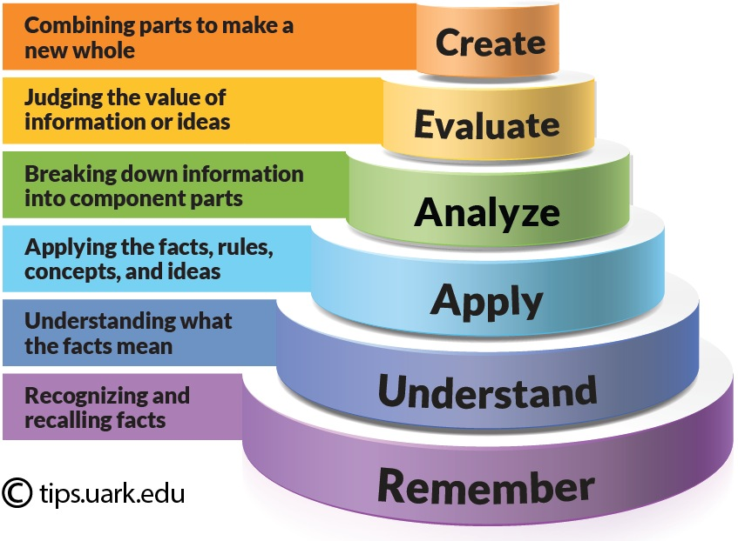
Bloom’s Taxonomy

Slide 28
AAU Education Principles
Professionalism
Interactivity
Complexity
The AAU Early Alert Form
Goal: to identify for the institution early in the term if a student is underperforming, or if something about their behavior has changed in way that concerns you
→ Show where to find this form on the AAU website ☺

Slide 29
AAU Education Principles
Professionalism
Interactivity
Complexity
The AAU Early Alert Form
Goal: to identify for the institution early in the term if a student is underperforming, or if something about their behavior has changed in way that concerns you
Goal: to support student learning and improve student retention

Slide 30
AAU Education Principles
Professionalism
Interactivity
Complexity
Assess students early (by week 5), continuously & using diverse methods
Use the Early Alert Form
Show connections to other subjects
Show practical implications & some applications of your subject material

Slide 31

AAU Education Principles
Professionalism
Interactivity
Complexity
Enthusiasm
Speak with enthusiasm as you teach
Design assignments and in-class activities you want to facilitate

Slide 32
AAU Education Principles
Teaching with Enthusiasm
Design assignments you want to facilitate
Help students “tie ideas together”
Remember your passion for your subject & that how you present is just as important as what you present
Student comment, 2023 data:
“The more engaging the class, the more we will respond and oftentimes that means not just reading off a PowerPoint every class.”

Slide 33
AAU student comments also support this argument
Qualitative student comment from AAU
Student Satisfaction Survey, Spring 2024
“I think that more class time should be devoted to student discussions and working through concepts together as a class. Personally I learn more when I can work through the topics myself, and I gain more valuable information talking with people who have alternative views with me instead of just being lectured at by a professor. I also feel like discussions help the students to feel more connected to their professors and so [maybe they] would be more likely to go and ask for help because they would have a closer relationship with the professor.”

Slide 34

AAU Institutional Learning Goals To teach our students:
Communication skills
Critical thinking
Effective & responsible action
“We need [teachers] to uphold democracy and the rights of everyone to be educated… to work for justice, changing our educational system so that schooling is
[a place where students] learn to open their minds,
to engage in rigorous study and to think critically.”
bell hooks, Teaching Community, A Pedagogy of Hope

Slide 35

Career Path
Teaching (FT or Adjunct) Track
Research Track
System of Ranks:
Accumulation of promotion points OR
Accumulated 5 years of service →
Promotion to a higher rank
+ increase in salary

Slide 36
Health Insurance
Employed FT faculty: AAU pays for VZP insurance automatically
Adjunct faculty:
Paid when you have DPČ
In most cases, lecturers don’t have DPČ in the summer months, so health insurance is not paid at that time
To check with HR your individual case:
michaela.proskocilova@aauni.edu

Slide 37

Sources of Institutional Regulation
Academic Codex
Faculty Handbook
Policies
All institutional documents can be found at AAUNET:
https://sites.google.com/a/aauni.edu/aaunet/

Slide 38
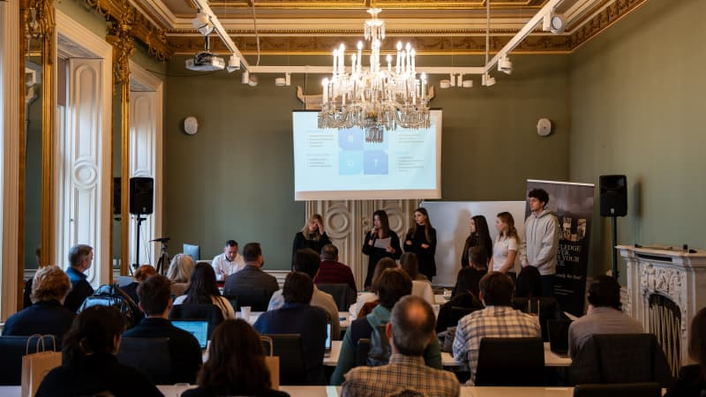
Semester Calendar
Academic Calendar
Show where to find on the AAU website
Classroom 2.07 is where Bi-Annual All-faculty meetings are held, in August and again in January, each year

Slide 39
End of Semester: Students complete course evaluations
Course evaluations are completed on NEO by students DURING CLASS in the week before your classes end
You will be reminded by your Dept. Chair by email a week or two before, to set aside time
Please give students time in class to do this… I myself set aside the first 15 minutes of class in the second to the last week of classes for students to complete evaluations. I remind them to bring their devices (to access evals. on NEO) and I step outside the room as they do.

Slide 40
NEO, our online Learning Management System
At AAU, you are required to use NEO to:
Post the Syllabus
Record weekly Attendance
Provide Feedback on assignments
Post Grades regularly
Post Lessons/Resources (recommended)

Slide 41

Learning Management System
At AAU, you are required to use NEO to:
Post the Syllabus
Record weekly Attendance
Provide Feedback on assignments
Post Grades regularly
Lessons/resources (recommended)
Also, be clear with your students…
Tell them directly your expectations
regarding technology use in your class.
(e.g., laptops, cell phones, ChatGPT/AI)

Slide 42
Teams & NEO Workshop Time
Introduce Peter Weis ☺
Explain AV classroom set-up, IT helpers
He & I can help with…
How to set up your course in NEO
How to add assignments, change images, etc.
Where to locate readings (Resources or calendar?)
Creating an exam/quiz, how to set up the grading
Any other questions you have about NEO/Teams
Notes:
One hour of info, then introduce Peter

Slide 43
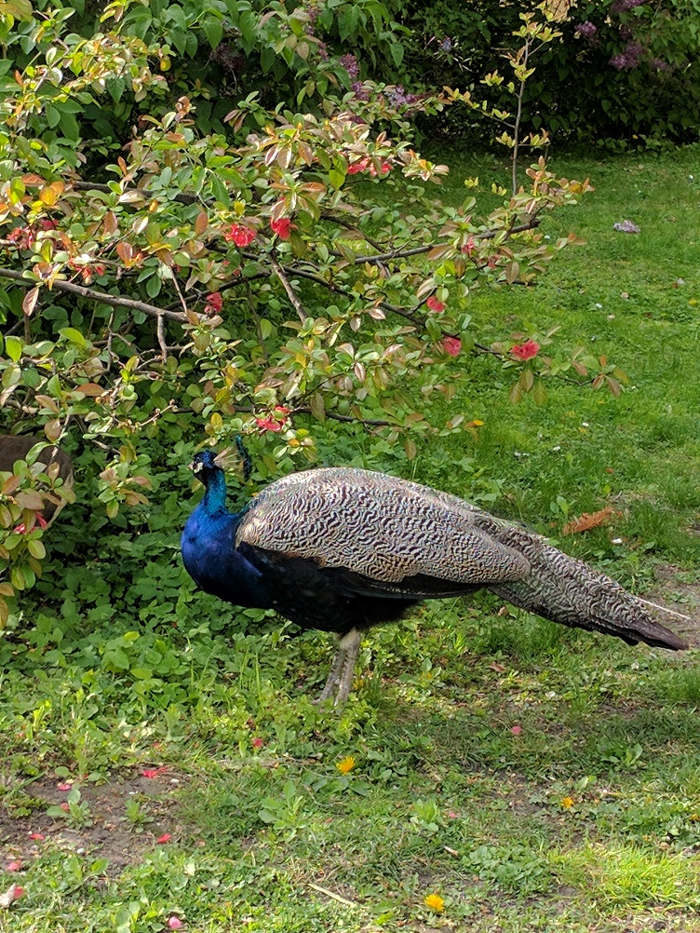
Lunch – 12:30 -13:00
These are the pretty peacocks that live in the park right behind the AAU campus…

Slide 44
Outline for today
10:00-12:00
Introductions
Education Principles, paired discussion
Semester Calendar
Learning Management System (NEO)
Virtual classroom (Teams)
Lunch break
13:00-14:00
Class Cancellation policy
Attendance, Grading, Plagiarism
Group discussion: Personalized Learning

Slide 45
Class Cancellation
Must inform your Dean & Department Chair
You must make up the cancelled class
AAU’s designated make up days are assigned to Fridays (please read the AAU Academic Codex, Section C)
Seek approval for a make-up date from your Dean or Department Chair

Slide 46
Class Cancellation Policy
If known in advance:
Propose a substitute instructor to the Chair
Default compensation: CZK 1000
Unexpected?
Inform your Dean, discuss what to do
You can teach online if the students agree
Send your students an email (or in NEO), and copy Dean & Department Chair
Email AAU Reception to post a note at the building entrance or outside your classroom

Slide 47

Attendance
Attendance is compulsory
Designated in-person students should be in class, you can let them attend online in the event of illness but it does not “count” for attendance
Attendance should be recorded weekly in NEO, it is easy to do this (on laptop or you can download the app. to your phone) and one less thing to do at end of semester

Slide 48
Attendance
Attendance is compulsory
Designated in-person students should be in class, you can let them attend online in the event of illness but it does not “count” for attendance
Designated online students attend in real time; audio is required (video is up to you) for them to earn their attendance

Slide 49
Attendance
Attendance is compulsory
Designated in-person students should be in class
Designated online students attend in real time
You are required:
To track attendance weekly & record it in NEO
Not to excuse absences (role of Dean of Students)
Excused absence → provide a make-up option
Too many absences → withdrawal

Slide 50
Grading
Use NEO
Stick to the syllabus
Do not offer extra credit unless you are willing to offer every student the opportunity
Special grades
Withdrawal
Failure to withdraw
Incomplete

Slide 51
Plagiarism
Strict approach
Plagiarism check built in NEO (TurnItIn.com)
You must use the specific DROPBOX format in NEO to use TurnItIn.com to assess papers
The software provides both a potential plagiarism score and (new) a potential AI match score (measures to what extent the paper might be written with AI)

Slide 52
Plagiarism
Plagiarism check built in NEO (TurnItIn)
You must use the specific DROPBOX format in NEO to use TurnItIn to assess papers
SHOW THIS: To select a TurnItIn Dropbox: at the top of the page click ADD to create a new assignment, click on the INTEGRATIONS tab, select a TurnItIn type of Dropbox
Students must upload their document to this Dropbox, note that if they email you a paper @aauni.edu there is no way to use TurnItIn.com unless creating specific Dropbox which offers this service and asking students to upload their papers there

Slide 53
Plagiarism
Strict approach
Plagiarism check built in NEO (Turnitin)
Refer students to the syllabus for types of plagiarism, included in all AAU syllabi
Any concern about plagiarism →
Contact your Dean and discuss the situation before accusing any student
Sometimes a paper can look like AI was used, but in fact it was not
I can also help you as needed ☺

Slide 54

Considering ChatGPT / AI use
Professors at educational institutions around the world are struggling to figure out what to do now following the emergence of ChatGPT / AI.
Our students are also trying to figure out how best to navigate the educational experience now that AI-assisted writing tools are available.

Slide 55
Considering ChatGPT / AI use
WHAT – exactly – constitutes cheating is hard to define (e.g., yes, having ChatGPT write an entire paper is obviously cheating, but what about having it edit a paragraph the student originally wrote?)
E.g., AAU permits the use of Grammerly to help ESL students improve their written presentation in English
On the CTL webpage: a video from our CTL workshop discussion in Fall 2024 offers several ideas regarding AI use/concerns
What questions do you have at this time?

Slide 56
Outline for today
Introductions
Education Principles, paired discussions
Semester Calendar, then workshop time:
Learning Management System (NEO)
Virtual classroom (MS Teams)
30 minute lunch break
Class Cancellation policy
Attendance, Grading, Plagiarism
Sources of Regulation
Group discussion: Personalized Learning

Slide 57
Personalized Learning
Frequent feedback helps students construct their knowledge and engages them in a deeper process of understanding
(Askew & Lodge, 2000)
Tell your students what you expect from them on specific assignments
Use formative feedback not just summative
Use positive, supportive comments not just constructive criticism

Slide 58
AAU Mission, Vision, and Values
What is personalized learning? M.Svoboda, VPAA
Mission: AAU prepares learners for a meaningful and prosperous life by cultivating critical thinking, effective communication and responsible action through personalized and transformative learning.
Values
Academic Excellence
Personal attention to learners: Instruct in small, dynamic groups using real-world experience, seminar and project-based methodologies that identify and meet individual learner needs and support their continuous development.
Diversity, Inclusivity and Multiculturalism
Social Consciousness
Shared Governance

Slide 59
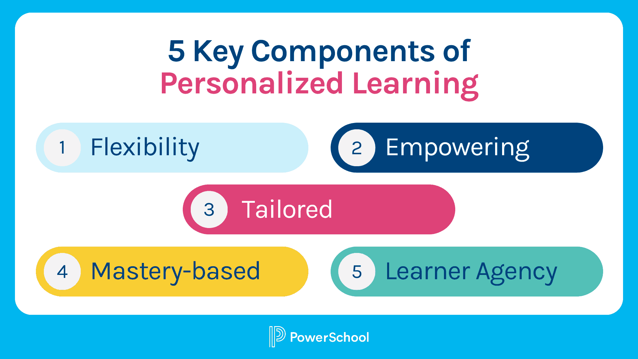
What Personalized Learning is NOT: - It is not “coddling” or “babysitting” students – they are young ADULTS - It is not a directive to “make exceptions” or “offer additional extra credit” for underperforming students; any extra credit must be offered to all students - It is not a directive for faculty to add additional (unreasonable) working hours

Slide 60
Personalized Learning
Paired Discussions:
What do you do already, in your teaching process, to support students individually?
Think carefully…
Emails, before & after class or at break
Giving written or oral feedback

Slide 61

At AAU, we believe in Strong Teaching Practice!
Prepare well - before the term, and before each class - for success

Slide 62
At AAU, we believe in Strong Teaching Practice!
Prepare well
Communicate with students often - in class, by email and online - to support student success

Slide 63
At AAU, we believe in Strong Teaching Practice!
Prepare well
Communicate with students often
State your learning goals – related to course content or the learning process - at the beginning of each class

Slide 64

At AAU, we believe in Strong Teaching Practice!
Prepare well
Communicate with students often
State your learning goals
Provide students with a daily outline - show them when they can expect conceptual application, in-class activities, & breaks

Slide 65
At AAU, we believe in Strong Teaching Practice!
Prepare well
Communicate with students often
State your learning goals
Provide students with a daily outline
Use a presentation structure that builds on itself and flows well, do not teach too much material too quickly

Slide 66

At AAU, we believe in Strong Teaching Practice!
Prepare well
Communicate with students often
State your learning goals
Provide students with a daily outline
Use a presentation structure that builds on itself and flows well
Move between teaching methods to “break up” the class (three hours) into smaller segments

Slide 67

Thank you for attending!
Additional questions?
Angel.Hoekstra@aauni.edu
Peter.Weis@aauni.edu

