Slide 1
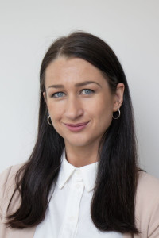
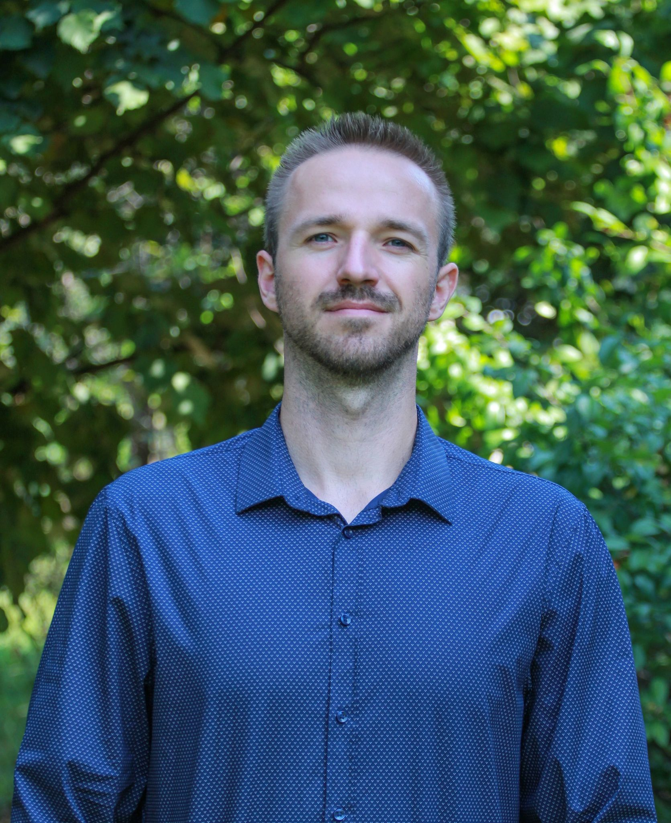
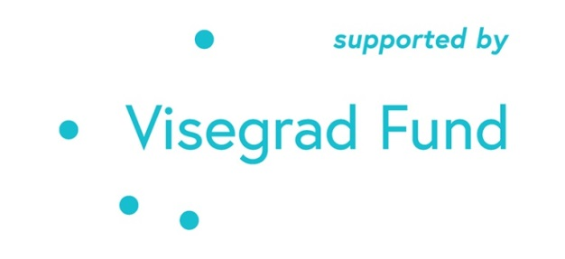
Comparing Responses to the Covid-19 Pandemic: Alternative Leadership Styles in the V4. The Hungarian Case.
The Hungarian team
The project is co-financed by the Governments of Czechia, Hungary, Poland, and Slovakia through Visegrad Grants from International Visegrad Fund. The mission of the fund is to advance ideas for sustainable regional cooperation in Central Europe. Project # 221201103.
A lecture for universities
Name: Anna Ujlaki
Affiliation: Centre for Social Sciences
Position: Junior Research Fellow
Contact info: Ujlaki.Anna@tk.hu
Name: Tamás Tóth PhD
Affiliation: University of Public Service
Position: Assistant professor
Contact info: toth.tamas3@uni-nke.hu
Presenter: Tamás Tóth

Slide 2
Schedule of the lecture
Introducing the project
Conceptualizing the main theoretical perspective (populism) in detail
Clarifying populism via specific instances
Describing preliminary findings
Providing the related findings during the grant period

Slide 3
Thin or thick ideology?
Mudde:
‘an ideology that considers society to be ultimately separated into two homogeneous and antagonistic groups, “the pure people” versus “the corrupt elite,” and which argues that politics should be an expression of the volonté générale (general will) of the people’ (Mudde, 2004, p. 543).

Slide 4
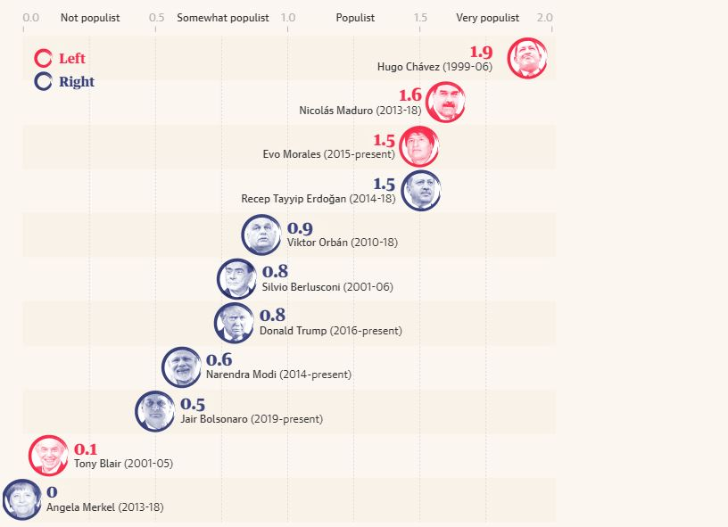

Slide 5
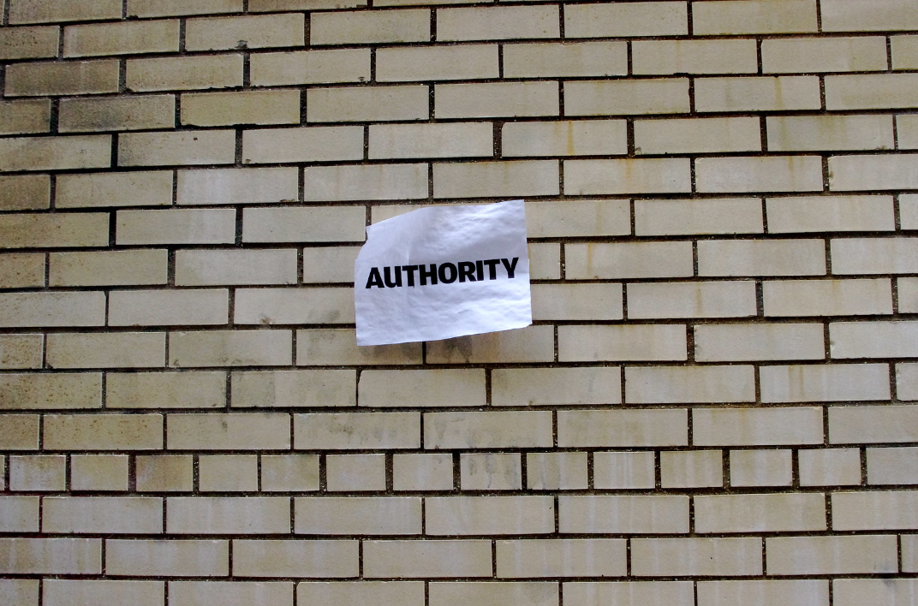
The (prevented) populist moment

Slide 6
There is no populist moment in this case

Slide 7
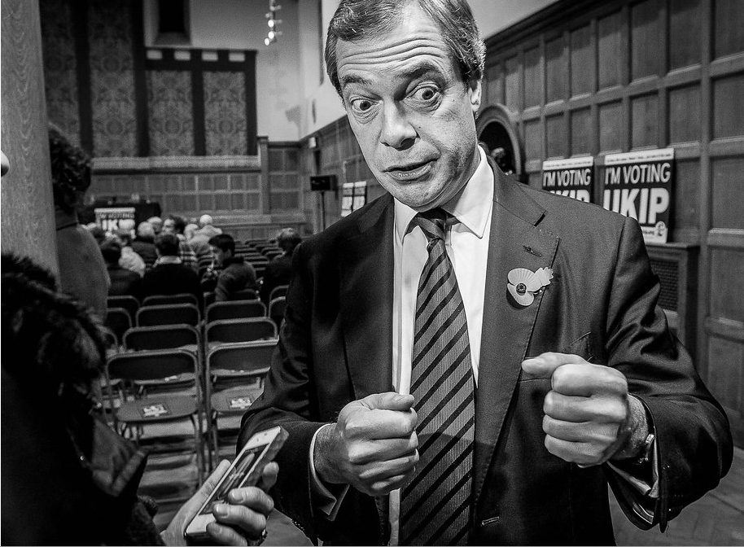
The populist moment
I do not seek the common denominator in demands. Instead, I construct one.

Slide 8
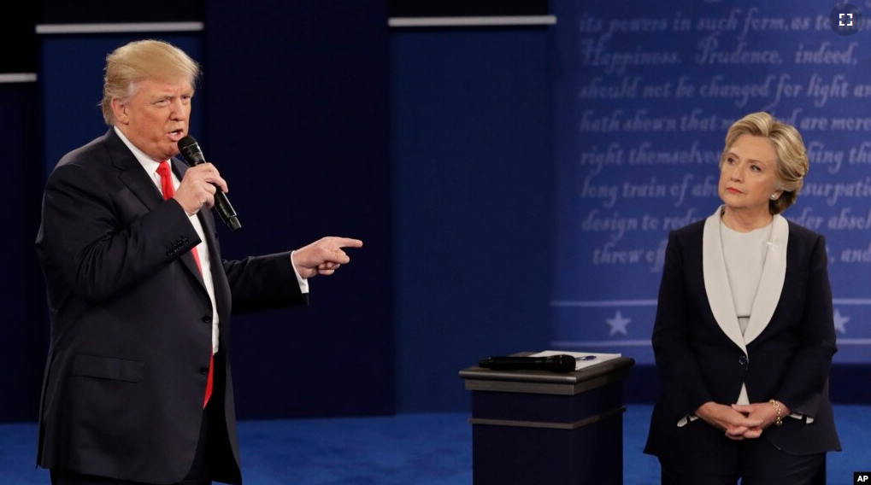
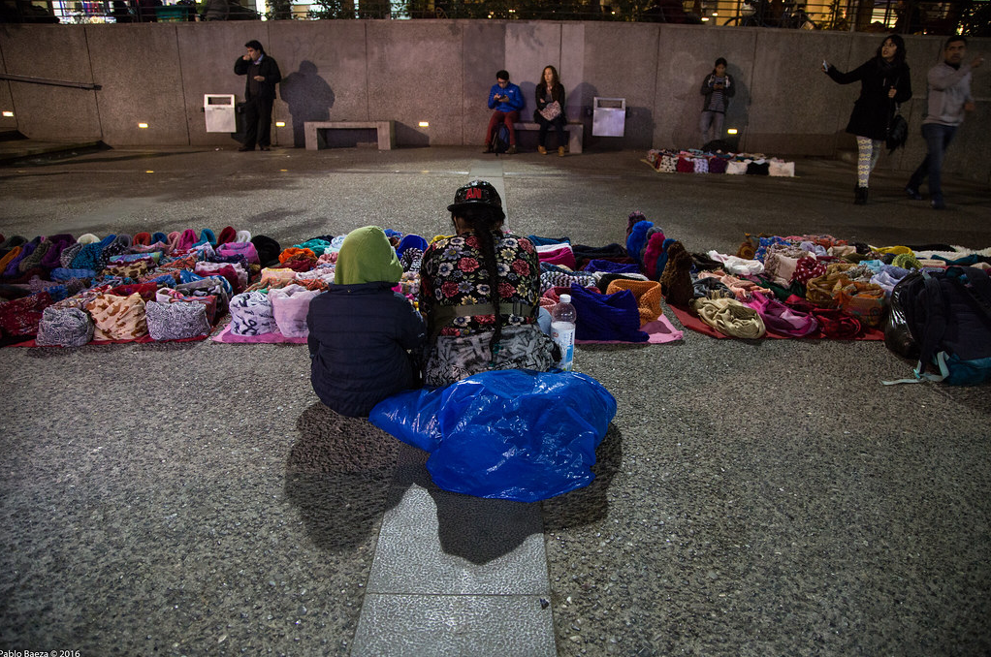
The populist moment
The elite is the problem because it supports immigrants rather than its own people!
Populists do not seek the common denominator but create one or few.
 |  |  |  |  |  |  |  |  |  | Other
P 1 | ✔ | ✔ | 🗶 | ✔ | 🗶 | 🗶 | ✔ | 🗶 | 🗶 | ✔
P 2 | 🗶 | ✔ | ✔ | 🗶 | 🗶 | ✔ | 🗶 | ✔ | 🗶 | 🗶
P3 | ✔ | ✔ | 🗶 | ✔ | ✔ | ✔ | 🗶 | 🗶 | ✔ | 🗶
SUM | 2 | 3 | 1 | 2 | 1 | 2 | 1 | 1 | 1 | 1

Slide 9
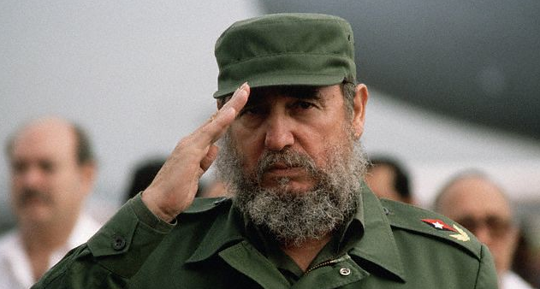
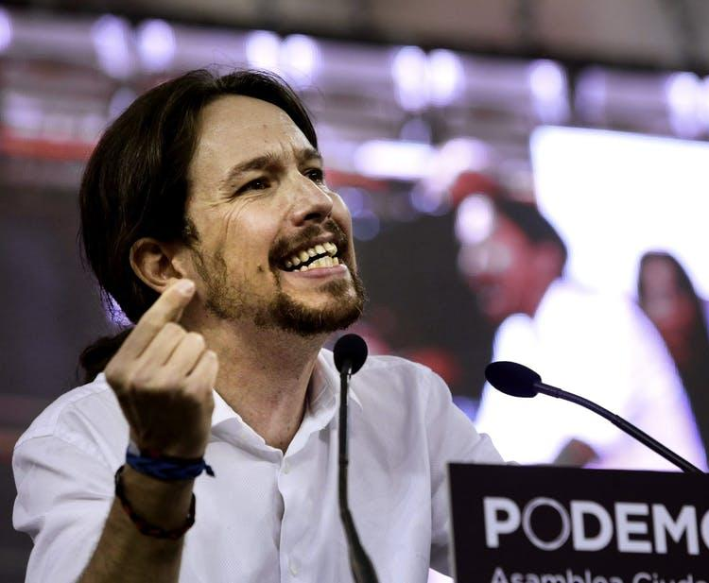
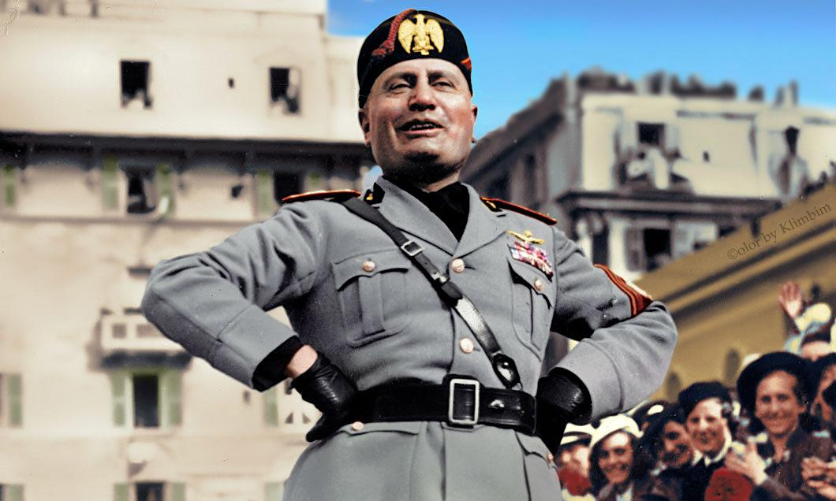
Some differences between communism, fascism, and populism

Slide 10
Challenging the approach of ideology
Aslanidis: discursive aspect
There is no cohesion!
Take it or leave it nature. How to measure the degrees of populism???
It also lacks
internal integration,
a rich core attached to political approaches,
the ability to provide political concepts,
the provision of answers for political questions,
extensive ideational scope,
cohesive ideological background,
unification among ideologists.

Slide 11
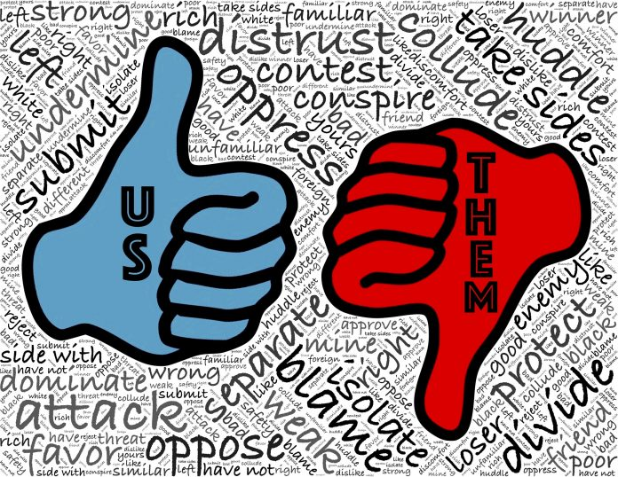
Theoretical concept
Jagers, J., & Walgrave, S. (2007). Populism as political communication style: An empirical study of political parties' discourse in Belgium. European Journal of Political Research, 46(3), 319-345.
"…political communication style, one that contains a central binary between »us« and »them«..."Aalberg 2016
Bonikowski, B., & Gidron, N. (2015). The populist style in American politics: Presidential campaign discourse, 1952–1996. Social Forces, 94(4), 1593-1621.
1. "Democrats rely primarily on economic populism and Republicans rely primarily on anti-statist populism."
2. "The longer a candidate’s political career, the lesser his reliance on populist rhetoric."
3. Decreasing tendency of using populist terms as an incumbent candidate in the second election

Slide 12
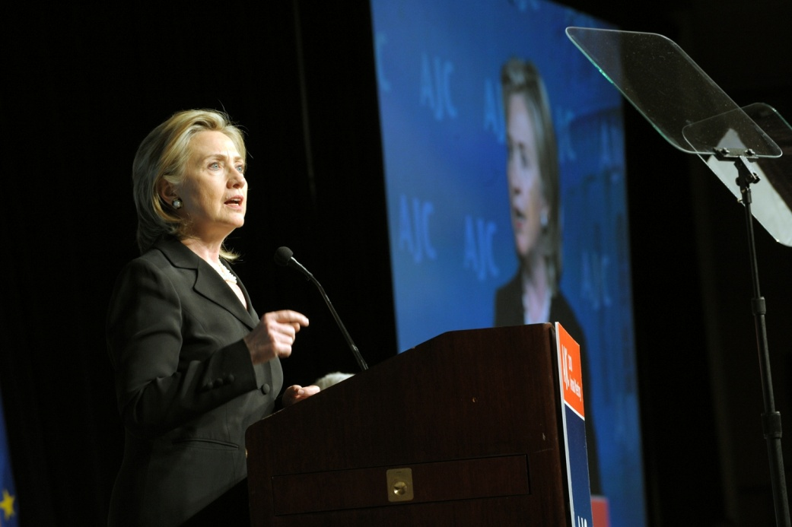
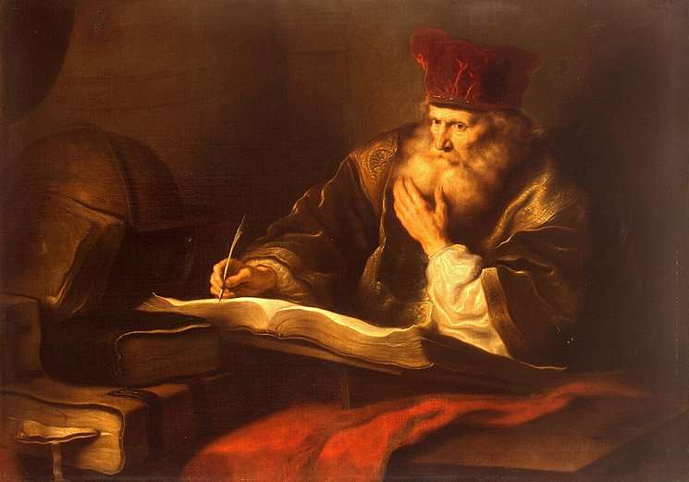
Vertical populism

Slide 13
Horizontal populism
Exclusionist
Welfare state chauvinist
In-group superiority which emphasizes national culture and habits' preeminence

Slide 14
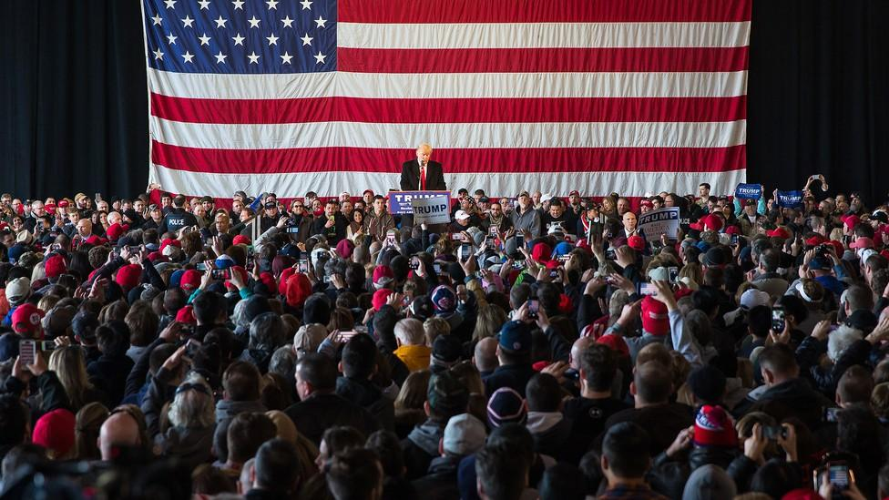
The populist citizen I.
Distinction between the pure people and the corrupt elite.
An antagonistic relationship between the pure people and the corrupt elite.
Populists represent the general will.

Slide 15
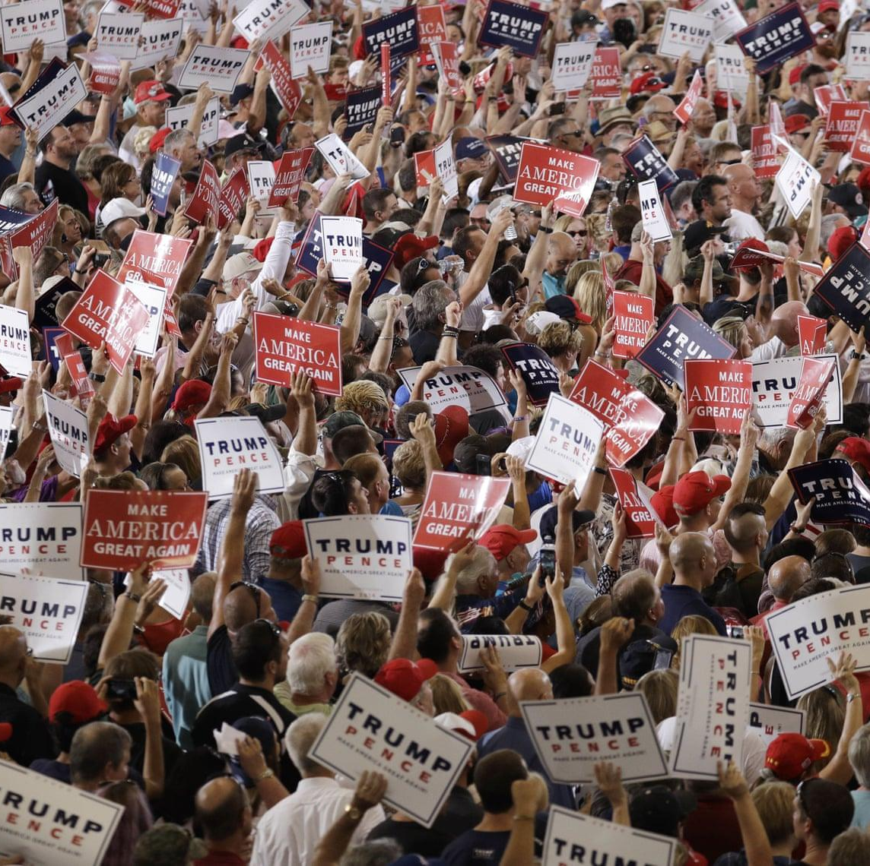
The populist citizen II.
The politicians in the Parliament need to follow the will of the people.
The people, and not the politicians, should make the most important political decisions.
The political differences between the elite and the people are larger than the differences among the people.
I would rather be represented by an ordinary citizen than by a professional politician.
Elected officials talk too much and take too little action.
What people call ‘compromise’ in politics is really just selling out on one’s principles.

Slide 16
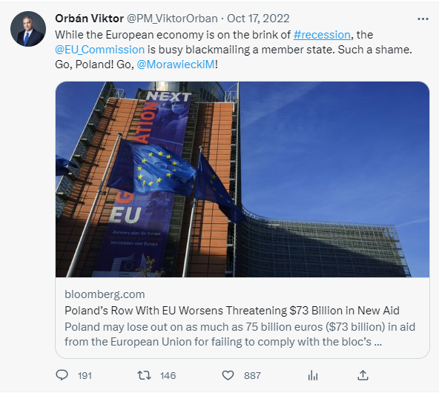
Explicit Populism
 | S I | S II | S III | S IV | S V | S VI | S VII | S VIII
‘Corrupt’ Elite | ✔ | ✔ | 🗶 | 🗶 | ✔ | ✔ | 🗶 | 🗶
‘Dangerous’ Minorities | ✔ | 🗶 | ✔ | 🗶 | ✔ | 🗶 | ✔ | 🗶
‘Good’ People | ✔ | ✔ | ✔ | ✔ | 🗶 | 🗶 | 🗶 | 🗶
Explicit Populism | ✔ | ✔ | ✔ | 🗶 | 🗶 | 🗶 | 🗶 | 🗶
Direct dichotomy!

Slide 17
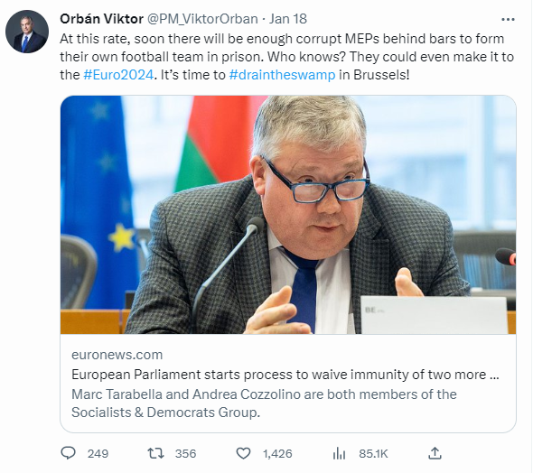
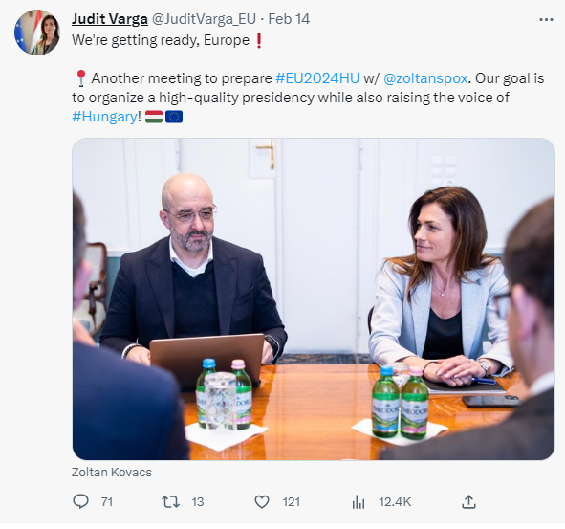
Implicit Populism
Type ‘A’:Antagonism
Type ‘B’: People-centrism

Slide 18
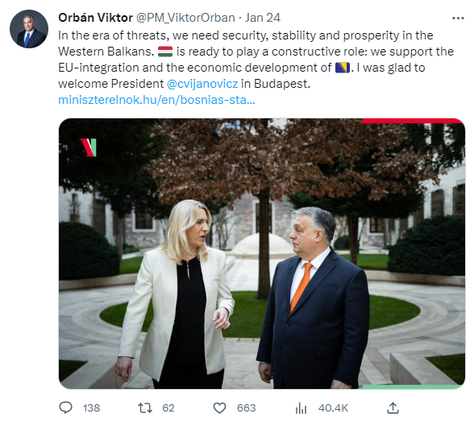
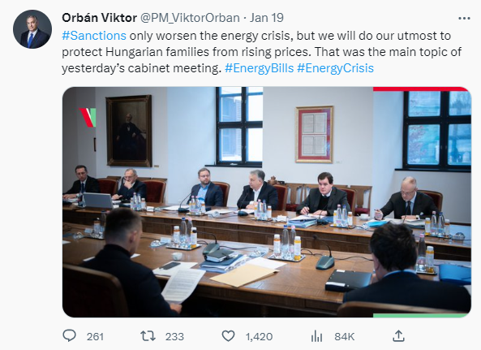
The tricky ones

Slide 19
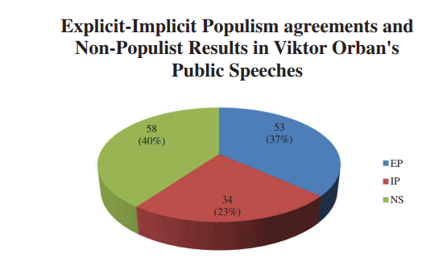
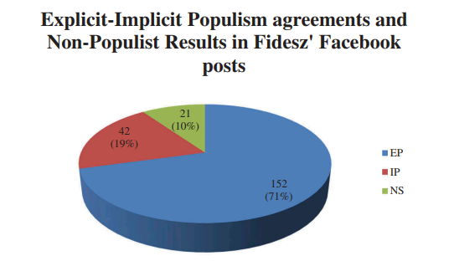
Explicit and Implicit Populism in Hungary in 2018
Viktor Orbán’s Speeches
Fidesz’s Facebook Posts

Slide 20
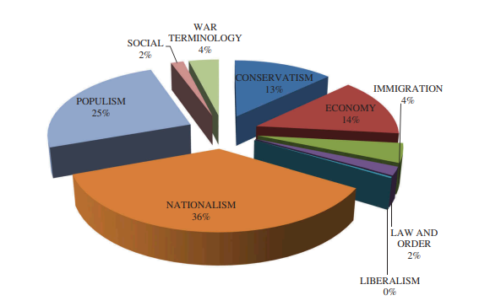
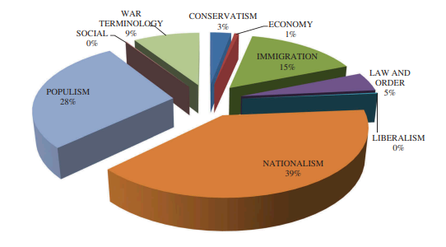
Political agenda during the 2018 parliamentary elections in Hungary
Viktor Orbán’s Speeches
Fidesz’s Facebook Posts

Slide 21
The Case Study
Leadership styles related to the COVID-19 pandemic
according to the Adaptive Leadership Framework
comparing to former leadership styles
with regard to the specificities of the regime
The research
data collection
Timeline of pandemic waves (cases, deaths, in hospital, in ventilation beds, conducted tests, rate of positive tests, received 1st vaccine, received 2nd vaccine)
Announcements on the official governmental page for COVID-19 pandemic (https://koronavirus.gov.hu/)
literature review of parallel pandemic-related research on Hungary (e. g. Szabó-Körösényi-Böcskei 2020)
mixed-method content analysis (Maxqda 2022)
comparative study: Viktor Orbán’s „pandemic speeches and previous campaign communication styles”
Media appearance: https://mandiner.hu/cikk/20221031_populizmus_covid_v4_kutatas

Slide 22
Identifying the main values and priorities
low consistency
1st wave: citizens’ health over economy
2nd wave: protecting jobs and economy has become the most salient topic
controversial positions on vaccines among MPs
the decision is channeled into an often-used governmental campaign tool (National Consultation)
pandemic-related decisions: political factors over technical factors
extensive „stay at home” campaign with celebrities

Slide 23
Business as usual: the communication style of Viktor Orbán in the epidemic
Time range: between 5 March 2020 and 17 February 2021
No. of speeches: 51
Implicit populism: either people-centrism or antagonism appears solely in the same unit of analysis.
Explicit populism: both people-centrism and antagonism are perceived within the same unit of analysis.
H1: Nationalism is the most frequent topic category characterizing Viktor Orbán’s speeches.
RQ1: To what extent do topic categories emerge within Viktor Orbán’s speeches?
H2: People-centrism is the most frequent feature of the populist style within Viktor Orbán’s speeches.
RQ2: To what extent anti-elitism and the volonté general do emerge within Viktor Orbán’s speeches?
RQ3: How many explicit populist messages do emerge within Viktor Orbán’s speeches?

Slide 24
Viktor Orbán’s political agenda between 5 March 2020 and 17 February 2021
Time range: between 5 March 2020 and 17 February 2021

Slide 25
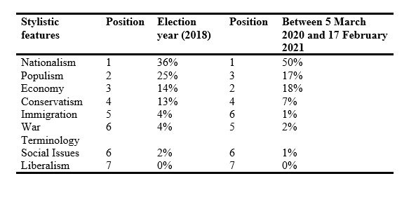
Comparing the styles of the Hungarian PM from 2018 and 2022-23

Slide 26
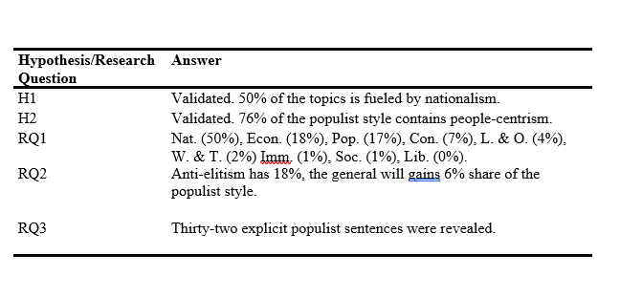
Summary
H1: Nationalism is the most frequent topic category characterizing Viktor Orbán’s speeches.
RQ1: To what extent do topic categories emerge within Viktor Orbán’s speeches?
H2: People-centrism is the most frequent feature of the populist style within Viktor Orbán’s speeches.
RQ2: To what extent anti-elitism and the volonté general do emerge within Viktor Orbán’s speeches?
RQ3: How many explicit populist messages do emerge within Viktor Orbán’s speeches?
Our content analysis shows that sixteen speeches imply explicit populism, less than one-third of the entire database. In contrast, people-centrism, which is part of the implicit populist political communication style, was perceived in ninety-two percent of the speeches. In sum, similarly to Tóth and colleagues’ (2022) findings, explicit populism is outperformed by the implicit populist style of Viktor Orbán on the level of core sentences.

Slide 27
Vaccinated and unvaccinated in Hungary
Tracing a new social stratification
Report
2022
Researchers: Márton Bene,* Gábor Dobos,* and Tamás Tóth**
*Centre for Social Sciences
**University of Public Service
OTKA – Funded by the National Research, Development and Innovation (NRDI) Office, PI: Márton Bene

Slide 28
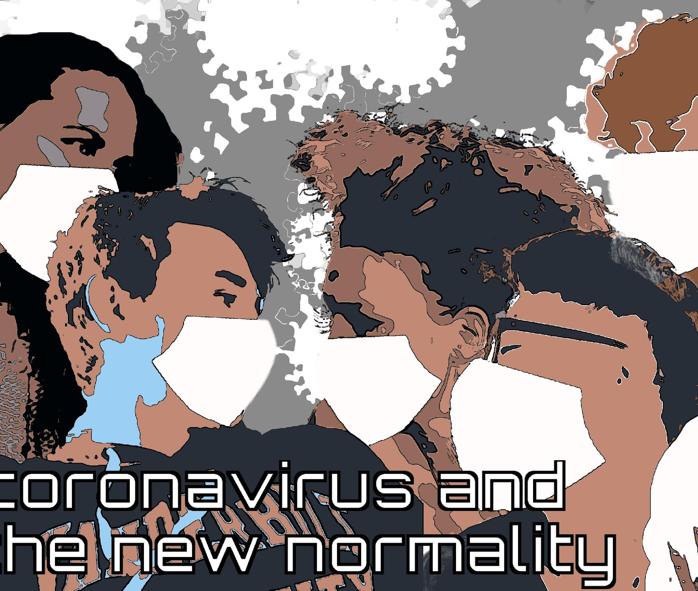
Background I – General information
In Hungary, the first coronavirus vaccine was administered on the day after Christmas 2020.
The issue of vaccination has become one of the most important public topics in 2021, a year marked by the third and fourth waves of the pandemic, which have proved to be even more severe than before in Hungary.
The more people decide to take up the vaccine against the coronavirus, the greater the chance that the pandemic can be contained and the reduced health, social and economic damage. It is therefore crucial to understand and explore the background to these personal decisions.

Slide 29
Background II – Information about the representative survey
The questionnaire survey was conducted by the Závecz Research Institute for Market and Social Research in November 2021 (between 8 and 20 November). The data was collected through a two-stage, proportionally stratified, randomly selected survey of 1,000 residents, and the sample is representative of the adult (over 18) population of the country’s gender, age groups, educational attainment, and type of residence.

Slide 30
Background III – The rates of being vaccinated in November 2021
At the time of the end of the recording, 6.18 million citizens had one, 5.79 million had two, and 1.77 million had three vaccinations.
It is important to note, however, that it had been possible for months for children over 12 years of age to register for the vaccination. These figures refer to the age group over 12 years of age, not just the adults.
In our sample, a rounded 4 percent of respondents received only one vaccination, 58 percent received two vaccinations and 19 percent received three vaccinations.
The proportion who received at least one vaccination is therefore 80 percent in round numbers and the proportion who did not receive one vaccination is 20 percent.

Slide 31
Background IV – The type of vaccines and their proportion among the Hungarian population
Almost half of the vaccinated (47%) received Pfizer vaccine as their first shot, with Sinopharm (15%), Sputnik (13%), Astra Zeneca (12%) and Moderna (10%) vaccines represent a similar proportion of the sample, while Johnson & Johnson vaccines account for only 3%.

Slide 32
Results I – Attitudes towards the vaccines
Vaccinated people feel protected from the harmful effects of the coronavirus, regardless of the vaccine they receive.
The unvaccinated are specifically protected against coronavirus are skeptical about vaccines developed specifically for coronavirus, and general opposition to vaccination or medicine is less popular.
Conspiracy theories about vaccinations are not among the leading reasons for not vaccinating. However, conspiracy theories are quite popular among the unvaccinated, and identification with them is independent of the education level of the respondents.

Slide 33
Results II – The emerging fracture between vaccinated and unvaccinated citizens
There are perceived differences between the vaccinated and unvaccinated groups, although these are related to personal responsibility. However, a quarter of the Hungarian society reported a strong dislike of the other group. All this suggests that vaccination has created a new type of social fracturedness.

Slide 34
Results III – Political partisanship and willingness to get vaccinated
Being vaccinated? | Fidesz–KDNP (government) | Left-wing opposition | Jobbik (far-right opposition) | Other parties (for instance, Mi Hazánk, far-right) | None | Total
No | 43 (11,9%) | 33 (15,7%) | 38 (35,8%) | 11 (47,8%) | 41 (26,6%) | 166 (19,4%)
Yes | 319 (88,1%) | 177 (84,3%) | 68 (64,2%) | 12 (52,2%) | 113 (73,4%) | 689 (80,6%)
Total | 362 (100%) | 210 (100% | (100%) | 23 (100%) | 154 (100% | 855 (100%)
χ2=50,259 · df=4 · Cramer’s V=0,242 · p=0,000
However, the proportion of unvaccinated is significantly higher among Jobbik (far-right). More than a third of Jobbik voters and almost half of voters of other parties (for instance, Mi Hazánk) are unvaccinated.
Among Fidesz-KDNP supporters, the rate of being unvaccinated is the smallest (12%); the same indicator among left-wing opposition voters is 16%, but this difference is not significant (p>0.05).

Slide 35
Results IV – Information consumpiton and social environment
Unvaccinated people rely more on Facebook when they consume political information, while vaccinated people place more importance on television and radio.
The sharpest differences between vaccinated and unvaccinated are in their social environment.
For those who have more unvaccinated people in their environment are much more likely to reject vaccination, while people with a majority of vaccinated tend to opt for vaccination themselves.

Slide 36
Thank you for your attention!

