Slide 1

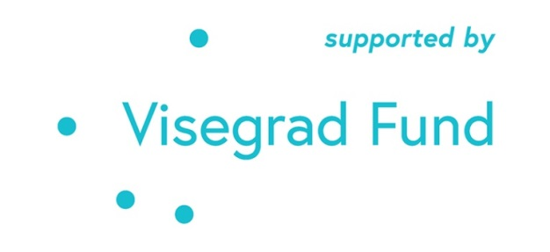
Leadership and the COVID-19 Pandemic in Hungary
The project is co-financed by the Governments of Czechia, Hungary, Poland and Slovakia through Visegrad Grants from International Visegrad Fund. The mission of the fund is to advance ideas for sustainable regional cooperation in Central Europe.
Tamás Tóth
University of Public service
Anna Ujlaki
Centre for social Sciences

Slide 2
Learning Outcomes
Understand leadership as a process, a relationship between leaders, followers and context.
Gain insight into the challenges that political leaders face during times of crisis.
Recognize what problems were inflicted In Hungary in terms of leadership during the pandemic.
Describe how to build interpersonal and social and institutional trust.
LEADERSHIP AND THE COVID-19 PANDEMIC IN HUNGARY. TAMÁS TÓTH AND ANNA UJLAKI

Slide 3
The Structure of the Lesson
What is leadership and why is it important to understand its mechanisms during situations such as the COVID-19 Pandemic.
What should be done in times of crisis (according to Adaptive Leadership Theory).
What has been implemented among the ideal responses to a crisis in Hungary during the Pandemic and what has not?
What would be needed to respond better to such situations?
Apply the lessons to our own lives and challenges.
LEADERSHIP AND THE COVID-19 PANDEMIC IN HUNGARY. TAMÁS TÓTH AND ANNA UJLAKI

Slide 4
COVID-19 and Leadership
Aspects:
health
economic
social
political
Affected the daily lives of every citizen!
LEADERSHIP AND THE COVID-19 PANDEMIC IN HUNGARY. TAMÁS TÓTH AND ANNA UJLAKI

Slide 5
The triadic nature of leadership
Leader(s)
Context
Followers
LEADERSHIP AND THE COVID-19 PANDEMIC IN HUNGARY. TAMÁS TÓTH AND ANNA UJLAKI

Slide 6
Adaptive leadership theory
Framing the problem
Prompt decision making and coordination
Transparency and communication
Fostering collaboration across sectors
Learning from past decisions and preparing for the future
LEADERSHIP AND THE COVID-19 PANDEMIC IN HUNGARY. TAMÁS TÓTH AND ANNA UJLAKI

Slide 7
Trust
A set of behaviors, such as acting in ways that depend on another.
Belief in a probability that a person will behave in certain ways.
An abstract mental attitude toward a proposition that someone is dependable.
A feeling of confidence and security that a partner cares.
A complex neural process that binds diverse representations into a semantic pointer that includes emotions.
LEADERSHIP AND THE COVID-19 PANDEMIC IN HUNGARY. TAMÁS TÓTH AND ANNA UJLAKI

Slide 8
Two Aspects of Interpersonal Trust
Cognitive
Affective
LEADERSHIP AND THE COVID-19 PANDEMIC IN HUNGARY. TAMÁS TÓTH AND ANNA UJLAKI

Slide 9
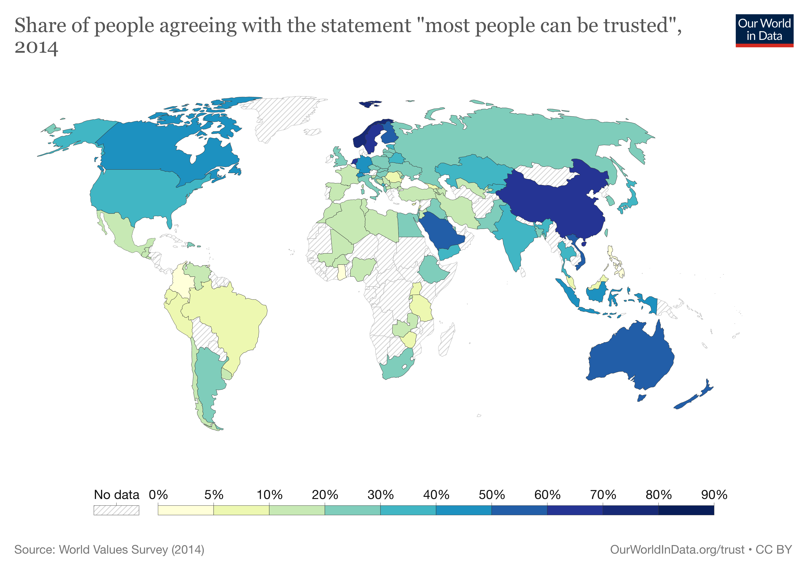
Do People Trust Each Other?
LEADERSHIP AND THE COVID-19 PANDEMIC IN HUNGARY. TAMÁS TÓTH AND ANNA UJLAKI

Slide 10
Social Trust
Social trust is defined as, “an individual’s expectation that other people and groups can be relied on…[It] is one of the most important synthetic forces within society. Not only is social trust an elixir for social functioning, but as part of a nation’s social capital, trust affects vital economic variables such as GDP growth and inflation rates.”
Source: Brandt, M.J., Wetherell, G. & Henry, P.J. (2015) Changes in Income Predict Change in Social Trust: A Longitudinal Analysis. Political Psychology, 36 (6)
LEADERSHIP AND THE COVID-19 PANDEMIC IN HUNGARY. TAMÁS TÓTH AND ANNA UJLAKI

Slide 11
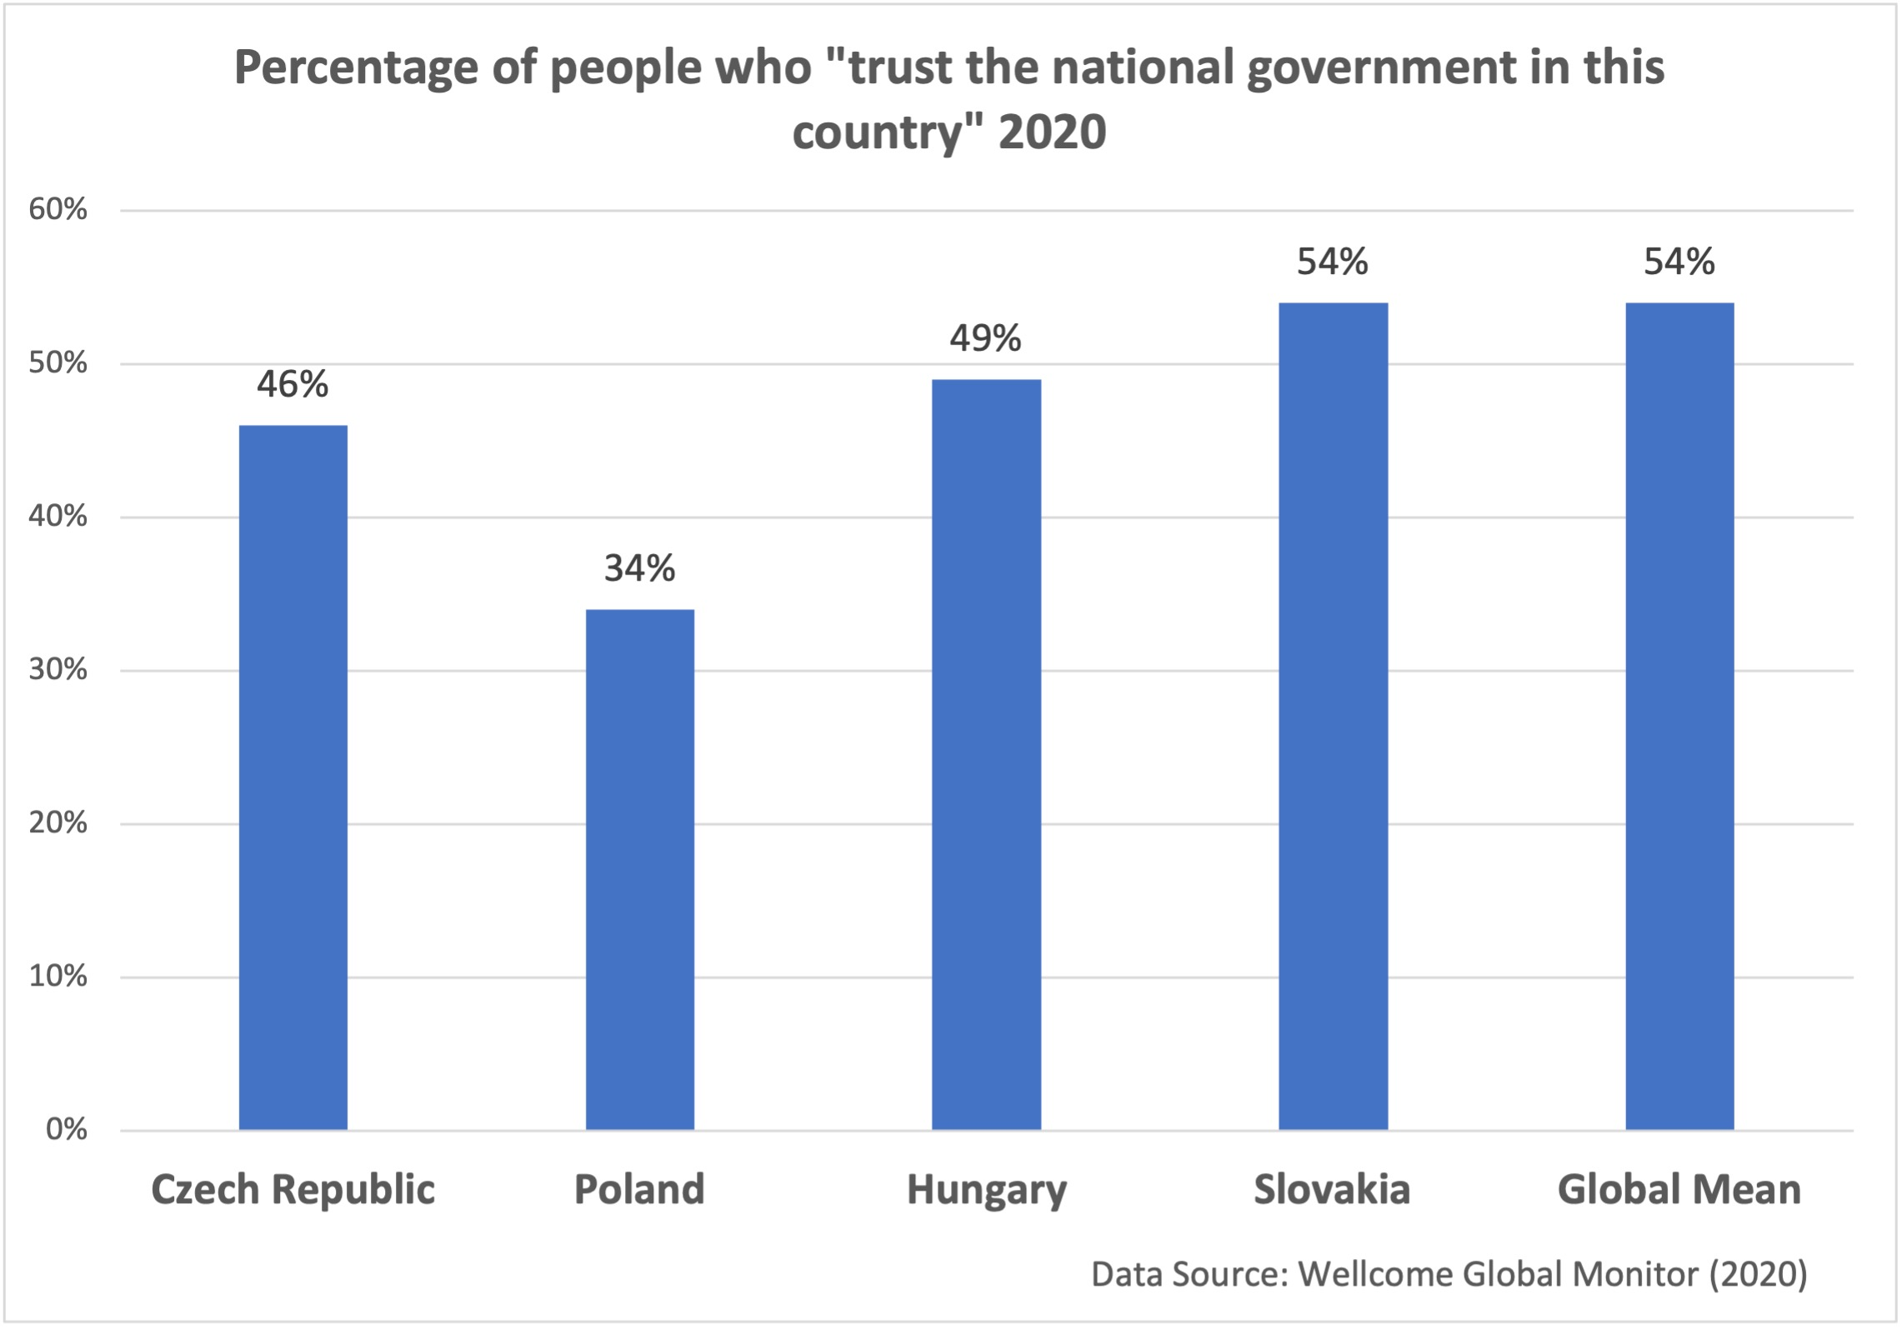
Do Hungarians Trust the Government?
LEADERSHIP AND THE COVID-19 PANDEMIC IN HUNGARY. TAMÁS TÓTH AND ANNA UJLAKI

Slide 12
Hungary: the Context
2010- electoral success of Viktor Orbán prime minister and the Fidesz-KDNP coalition
2011. Fundamental Law replaced the former Constitution (1949-)
  11 amendments
  2013. the Fourth Amendment: There is no rule of law in Hungary anymore?
    Plebiscitary leader democracy? (Körösényi 2017)
    Externally constrained hybrid regime? (Bozóki – Hegedűs 2017)
    Electoral autocracy? (Unger 2018)
    Modern autocracy? (Tóth G. A. 2021)
    Constitutional dictatorship? (Antal 2019)
    Dictatorship? (Vörös 2021)
    Illiberal democracy? (Orbán 2014)
LEADERSHIP AND THE COVID-19 PANDEMIC IN HUNGARY. TAMÁS TÓTH AND ANNA UJLAKI

Slide 13
Framing the Problem
From shock to a (partly) political game
Channeled into an existing narrative
  battle against „illegal migration” and „Brussels”
  curtailing opposition and local governments
  State of Emergency: extensive governmental powers
  battle against the „LMBTQ propaganda”
values:
  1st wave: health over economy
  2nd wave: economy over health
independent media’s attempts to raise awareness
low level of technical expertise
National Consultation (a governmental campaign tool)
„stay at home” campaign with celebrities
LEADERSHIP AND THE COVID-19 PANDEMIC IN HUNGARY. TAMÁS TÓTH AND ANNA UJLAKI

Slide 14
Decision-Making and Coordination
only short term alternatives
National Security Operative Board
working group for vaccine production
communication of decisions: three types
low involvement of organizations of GPs and academic community
LEADERSHIP AND THE COVID-19 PANDEMIC IN HUNGARY. TAMÁS TÓTH AND ANNA UJLAKI

Slide 15
Transparency
data witholding or delayed publication
conspiracy theories
no longer possible to ask questions from the Operative Board
banning media from hospitals
LEADERSHIP AND THE COVID-19 PANDEMIC IN HUNGARY. TAMÁS TÓTH AND ANNA UJLAKI

Slide 16
The communication style of Viktor Orbán during the Pandemic
LEADERSHIP AND THE COVID-19 PANDEMIC IN HUNGARY. TAMÁS TÓTH AND ANNA UJLAKI

Slide 17
Collaboration
common responsibilities and personal liabilities over joining forces
little evidence of involving voices of dissent
government’s advisors remain unknown
ambiguous information about restrictions and openings
vaccination intermissions
LEADERSHIP AND THE COVID-19 PANDEMIC IN HUNGARY. TAMÁS TÓTH AND ANNA UJLAKI

Slide 18
Learning and Preparing
trial and error type of decision-making is a low priority (for regime-specific reasons)
strong political leader in a crisis situation
only a few cases of correction
LEADERSHIP AND THE COVID-19 PANDEMIC IN HUNGARY. TAMÁS TÓTH AND ANNA UJLAKI

Slide 19
Conclusion: Building Interpersonal Trust
Enact solidarity: show care and concern for others and their interests.
Take responsibility instead of blaming situation or others.
Give help or assistance.
Invite and accept changes to your decisions.
Seek the advice of others.
Give responsibility to others, depend on them.
Be open and direct about task problems and motives.
Disclose information in an accurate and timely way.
LEADERSHIP AND THE COVID-19 PANDEMIC IN HUNGARY. TAMÁS TÓTH AND ANNA UJLAKI

Slide 20
Application: Final Questions
Do you think any of the above could be used by the Hungarian government to improve social trust with citizens? Why would it be good to improve social trust?
If you were working on a project with some classmates, how would you use a few of the above to build trust with them?

Slide 21
Thank you!
Please feel free to contact us: ujlaki.anna@tk.hu
LEADERSHIP AND THE COVID-19 PANDEMIC IN HUNGARY. TAMÁS TÓTH AND ANNA UJLAKI

