Slide 1
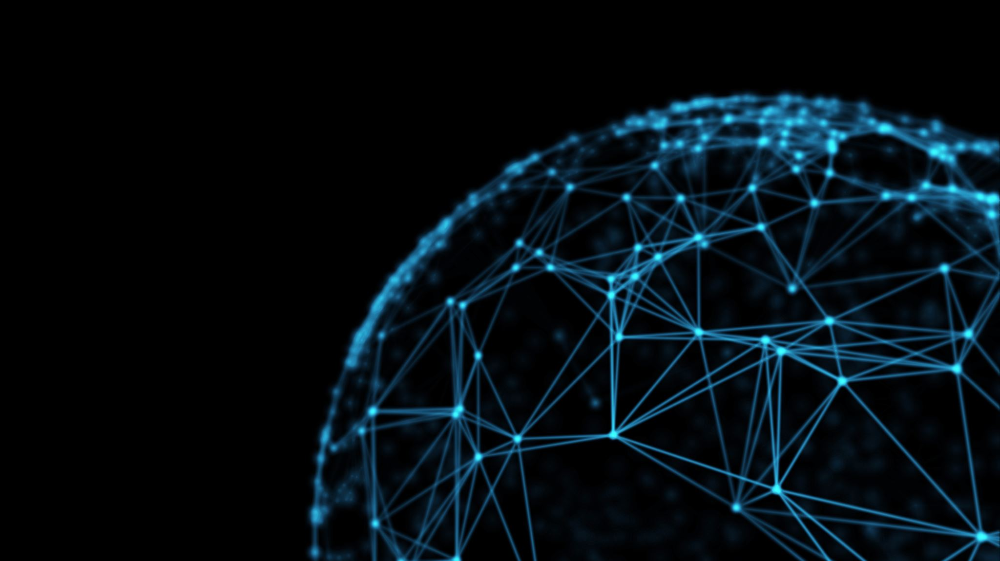
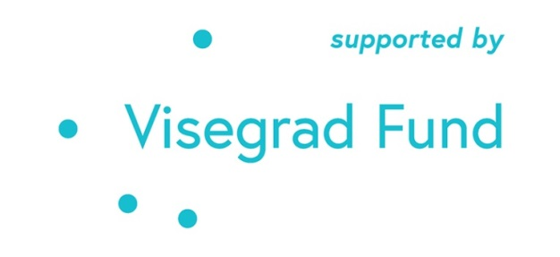
Trust and Leadership in Crisis and Beyond
The project is co-financed by the Governments of Czechia, Hungary, Poland and Slovakia through Visegrad Grants from International Visegrad Fund. The mission of the fund is to advance ideas for sustainable regional cooperation in Central Europe.

Slide 2
Learning Outcomes
Understand leadership as a process, a relationship between leaders, followers and context.
Integrate the concept of trust within the leadership process- its components and outcomes.
Apply the consequences of interpersonal and social trust within the crisis leadership during the COVID-19 pandemic.
Describe the how to build interpersonal and social/institutional trust.
Construct ways to build social and interpersonal trust in our own lives and communities.

Slide 3
Structure of the lesson
Read the case study
Respond to the challenge questions individually (or as a group)
Discuss resources that provide insights about the case
Learn about leadership and the role of trust
Discuss interpersonal and social trust in this country during the pandemic
Apply the lessons of trust to our own lives and challenges

Slide 4
Mann Gulch Case Study Challenge Questions
Why do you think the firefighters responded to Dodge the way they did?
Before and during the crisis, what are some things Dodge could have done to get the other fire fighters to trust his approach to the dangerous situation?
What is good leadership and what is its relationship to trust?

Slide 5
Insights about Mann Gulch
“[This] tragic story illustrates vividly that a leader’s style of communication and approach to making decisions shapes the extent to which he garners the trust and respect of his subordinates. Despite respect for a leader’s expertise and position of authority, individuals will not put their full and complete trust in someone who has not been open with them, built a relationship with them, and given them some input on past decisions. They also will not put their faith in someone who has not explained his rationale for past choices or illustrated how he approaches and solves tough problems.” (Michael Roberto, Why Great Leaders Don’t Take Yes for an Answer, pg. 219)

Slide 6
The triadic nature of leadership
Leader(s)
Context
Followers

Slide 7
Two aspects of interpersonal trust
Cognitive
Affective

Slide 8
Why is trust important?
We gain more information, helps us solve problems
Trust begets belonging
It makes our lives more efficient
Oxytocin released in the brain
It helps others

Slide 9
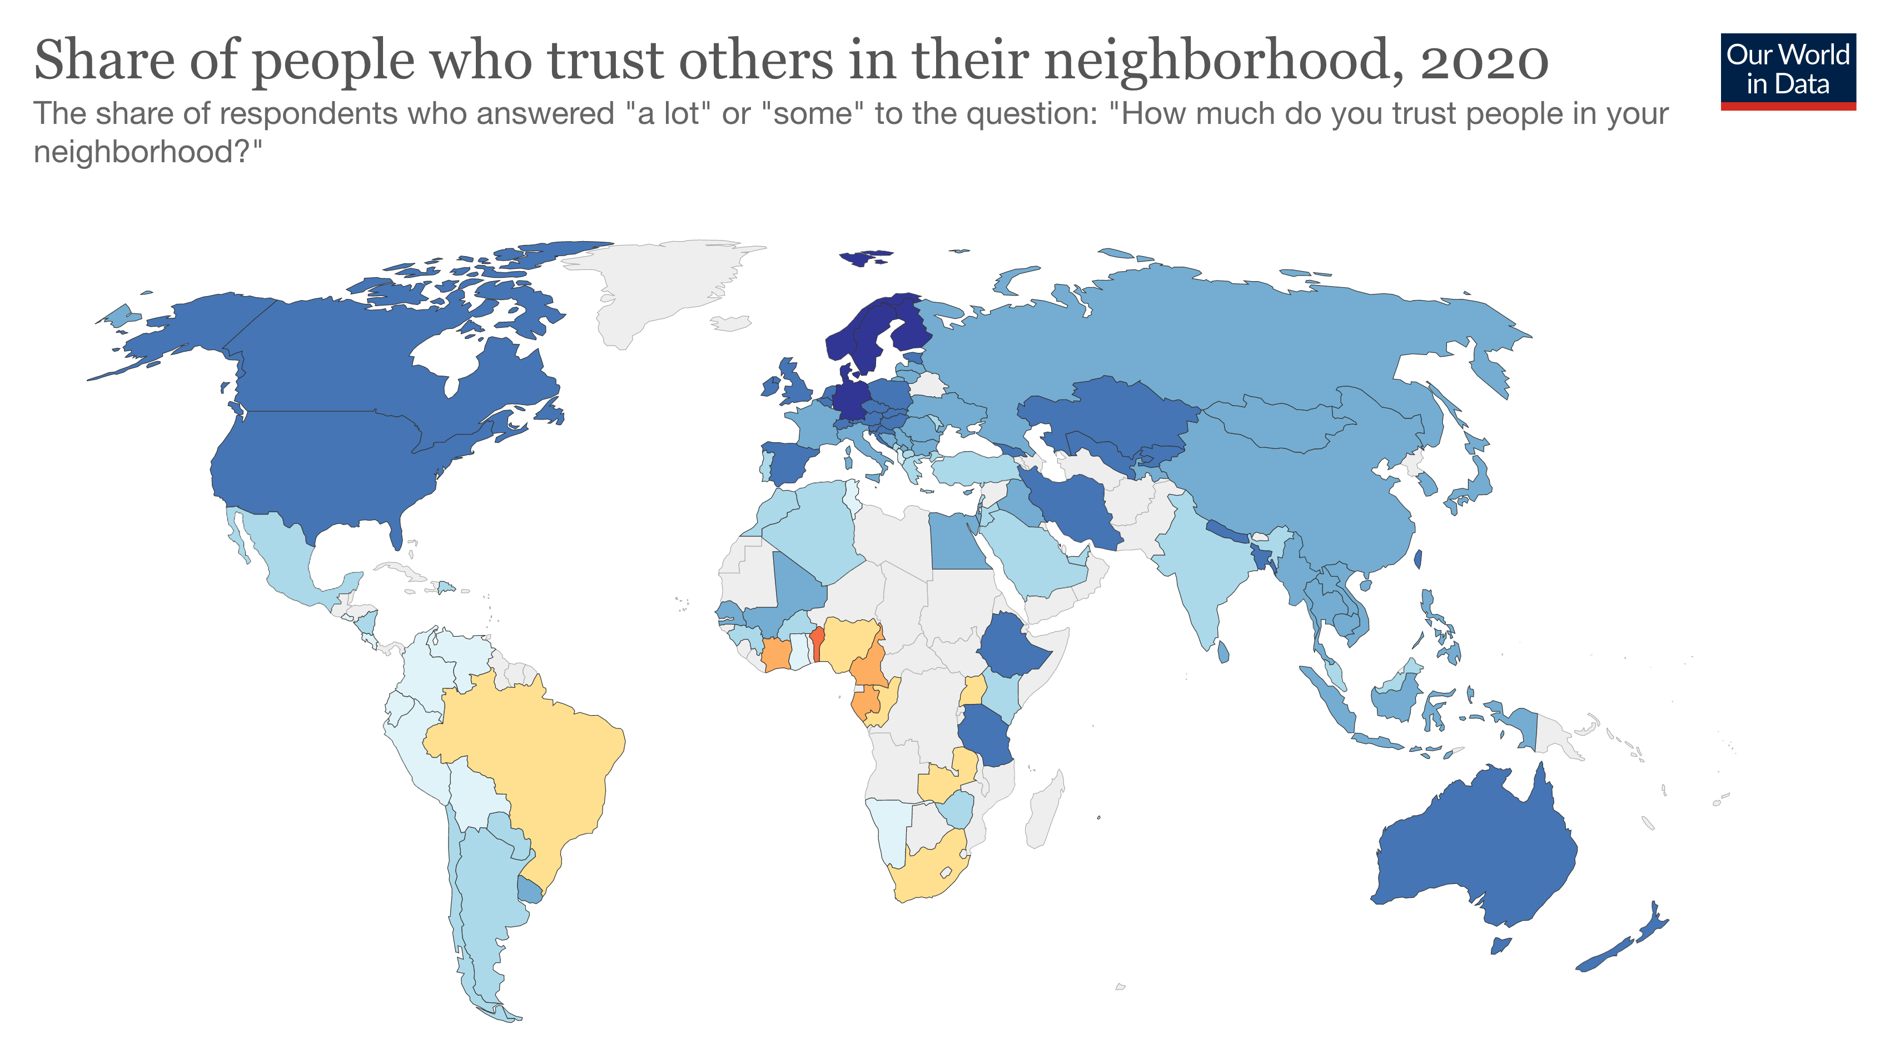

Slide 10
Populism breeds distrust
“At the end of 2020, the United States and Brazil had two of the highest number of COVID-19 cases globally, as well as COVID-19-related deaths. These numbers stood in stark contrast to those reported in other countries where expert advice had been followed. And this juxtaposition, we submit, evidenced to the people who had originally trusted Trump and Bolsonaro that, contrary to their message of self-trust, the people do not always ‘know best’. In a complex matter like COVID-19, common sense is not preferable to expert knowledge and analysis. The people are not competent to make decisions regarding COVID-19, including how to minimize the virus’s spread; they are in a ‘zone of incompetence’.”
  Vitale, D. & Girard, R. (2022) Public trust and the populist leader: A theoretical argument. Global Constitutionalism. Cambridge University Press.

Slide 11
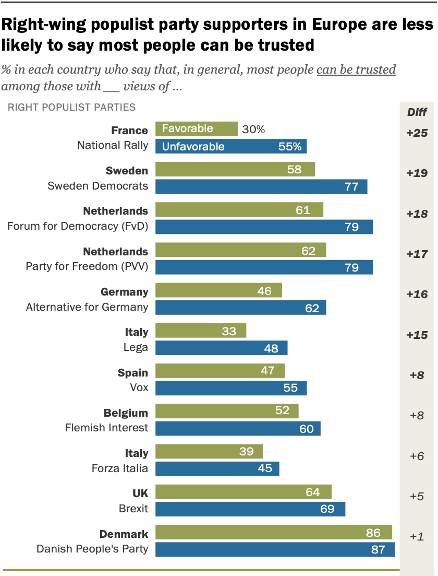
Populism breeds distrust
Pew Research Center, 2020 data

Slide 12
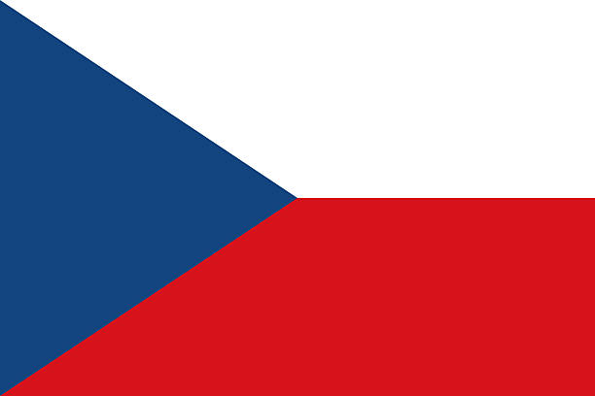
COVID-19 in the Czech Republic
“During the first wave, there was a “wartime” appeal to solidarity and social responsibility, the acceptance of which helped ensure a surprisingly minor caseload. This message was particularly strong around masking. Masking, as well as adhering to lockdown measures, were expressed in terms of group identity and group effort against a common enemy. The lack of victory after the combined individual as well as group sacrifice helped swing the pendulum from the Czech Republic being negligibly affected during the first wave to consistently being among the worst affected in subsequent waves.”

Slide 13
COVID-19 in the Czech Republic
“Individual statements of information were disseminated broadly and clearly during the pandemic. The problem emerges when the various bits of information are engaged with across time and across waves. Clear statements about what is going on beyond the immediate day of reference are noticeably inconsistent. Within the time period of a few days, the government could reverse its declared policy position. Businesses and schools were allowed to reopen only to be limited or closed in short order. For safety, masks had to be worn in public transport except for the drivers, who one would expect would be at greatest risk of infection and vectoring. The information was disseminated across multiple media, as well as posted by businesses and other effected establishments. This did not translate to the information being easily understood.”

Slide 14
COVID-19 in the Czech Republic
“These mixed messages led to the pandemic response presenting a challenge to popular conceptualizations of science. Popularly conceived, science is a static statement of truth. In actuality, science is a dynamic process of searching for truth. As the pandemic progressed, statements by decision makers “supported by science” became less and less convincing. To the popular ear, science kept changing its mind. This gave far greater breathing space to anti-science and anti-leadership positions, muddying the waters of credibility. This situation would be bad enough if it were not exacerbated by the consequences of the health/economy debate within the government. Once it became evident that the worth of the individual lives of the population had ben reassessed, trust in the leadership and their claims to support were irreparably damaged.”

Slide 15
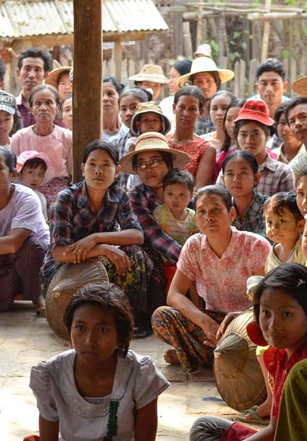
Social (institutional) trust
Social trust is defined as, “an individual’s expectation that other people and groups can be relied on…[It] is one of the most important synthetic forces within society.” Not only is social trust an elixir for social functioning, but as part of a nation’s social capital, trust affects vital economic variables such as GDP growth and inflation rates.”
Brandt, M.J., Wetherell, G. & Henry, P.J. (2015) Changes in Income Predict Change in Social Trust: A Longitudinal Analysis. Political Psychology, 36 (6).

Slide 16
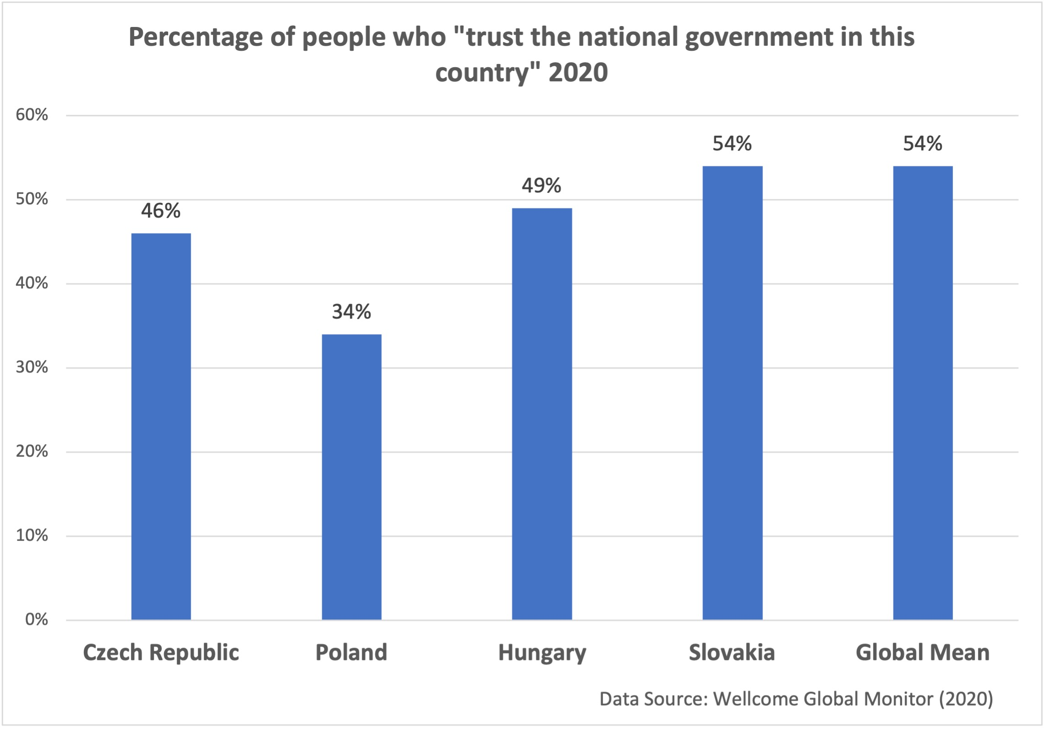

Slide 17
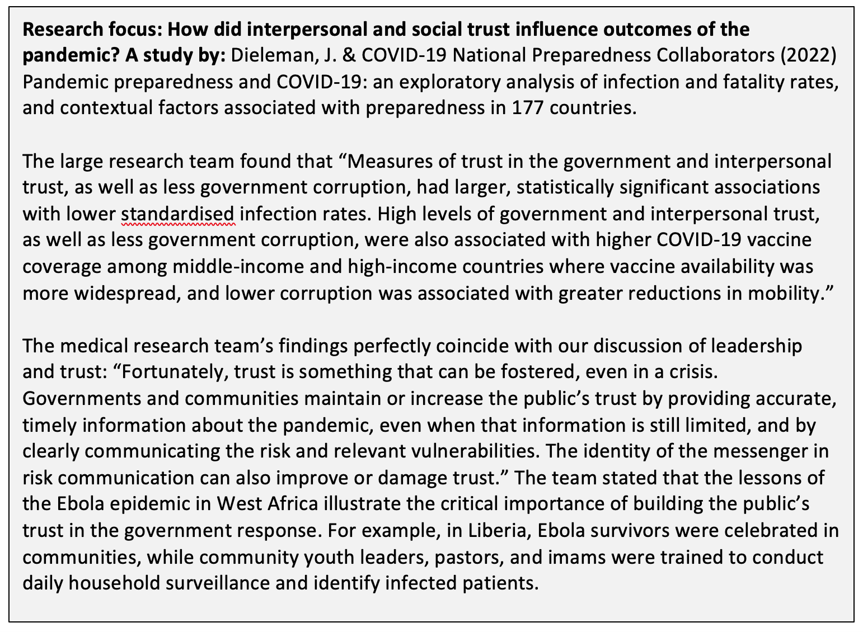

Slide 18
Building interpersonal trust
Enact solidarity: show care and concern for others and their interests.
Take responsibility instead of blaming situation or others
Give help or assistance
Invite and accept changes to your decisions
Seek the advice of others
Give responsibility to others, depend on them
Be open and direct about task problems and motives
Disclose information in an accurate and timely way

Slide 19
What about you?
There are many situations that you are in right now that you could be a leader and follower: among your friends, in the classroom, at your university, in the community. You may or may not have a formal position. If you see a change that is needed, will you take the initiative? If you do, then you will need to build trust with your collaborators. What have you learned from this lesson about it? Take the above lists on how to build social and interpersonal trust and apply them to one specific situation in your life:
How could you take steps to be more trusting?
How could you build trust with those with whom you work and study?

